Slide 1
Module 9: vSphere Clusters

Slide 2
Importance
Most organizations rely on computer-based services like email, databases, and web-based applications. The failure of any of these services can mean lost productivity and revenue.
By understanding and using vSphere HA, you can configure highly available, computer-based services, which are important for an organization to remain competitive in contemporary business environments. And by developing skills in using vSphere DRS, you can improve service levels by guaranteeing appropriate resources to virtual machines.

Slide 3
Module Lessons
vSphere Clusters Overview
vSphere DRS
Introduction to vSphere HA
vSphere HA Architecture
Configuring vSphere HA
Introduction to vSphere Fault Tolerance

Slide 4
Virtual Beans: vSphere Clusters
Virtual Beans has the following requirements for their data center:
Infrastructure must be highly available:
Business-critical applications: 99.99 percent available (downtime per year of 52.56 minutes)
Nonbusiness-critical applications: 99 percent available (downtime per year of 3.65 days)
Infrastructure must be scalable:
Virtual Beans expects huge growth over the next three years, so the virtual infrastructure must be easy to scale.
Applications must perform well:
Applications must have enough resources to meet performance levels as defined in the service-level agreement.
As a Virtual Beans administrator, you create a vSphere cluster architecture for the data center that is highly available, scalable, and high-performing.

Slide 5

Lesson 1: vSphere Clusters Overview

Slide 6
Learner Objectives
After completing this lesson, you should be able to meet the following objectives:
Describe the benefits of vSphere clusters
Create a vSphere cluster
View information about a vSphere cluster

Slide 7
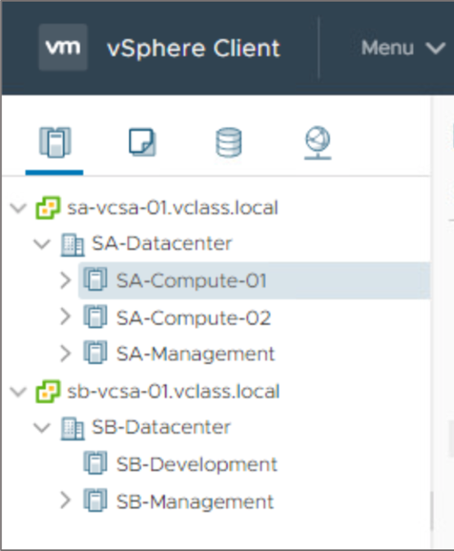
About vSphere Clusters
A cluster is used in vSphere to share physical resources between a group of ESXi hosts. vCenter Server manages cluster resources as a single pool of resources.
You can create one or more clusters based on the purpose each cluster must fulfill, for example:
Management
Production
Compute
A cluster can contain up to 64 ESXi hosts.

Slide 8
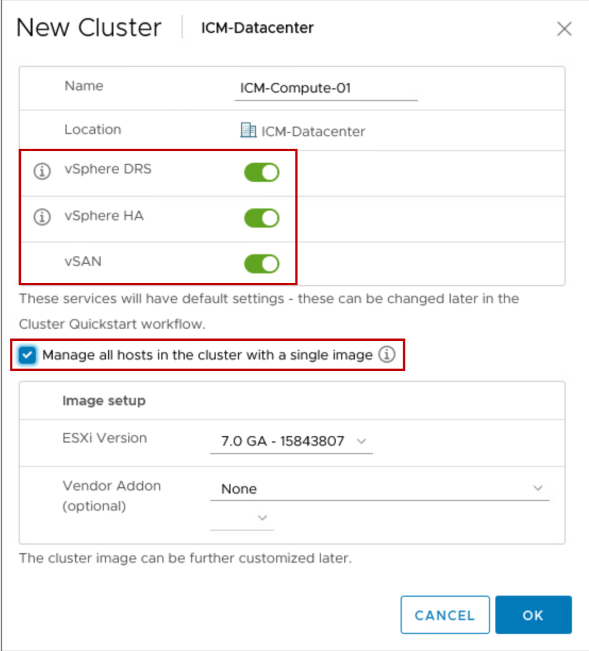
Creating a vSphere Cluster and Enabling Cluster Features
When you create a cluster, you can enable one or more cluster features:
vSphere DRS
vSphere HA
vSAN
You can also manage image setup and updates on all hosts collectively.
Notes:
You can enable the following services in a vSphere cluster:
vSphere HA, for high availability
vSphere DRS, for VM placement and load balancing
vSAN, for shared storage
You can also manage host updates using images. With vSphere Lifecycle Manager, you can update all hosts in the cluster collectively, using a specified ESXi image.

Slide 9
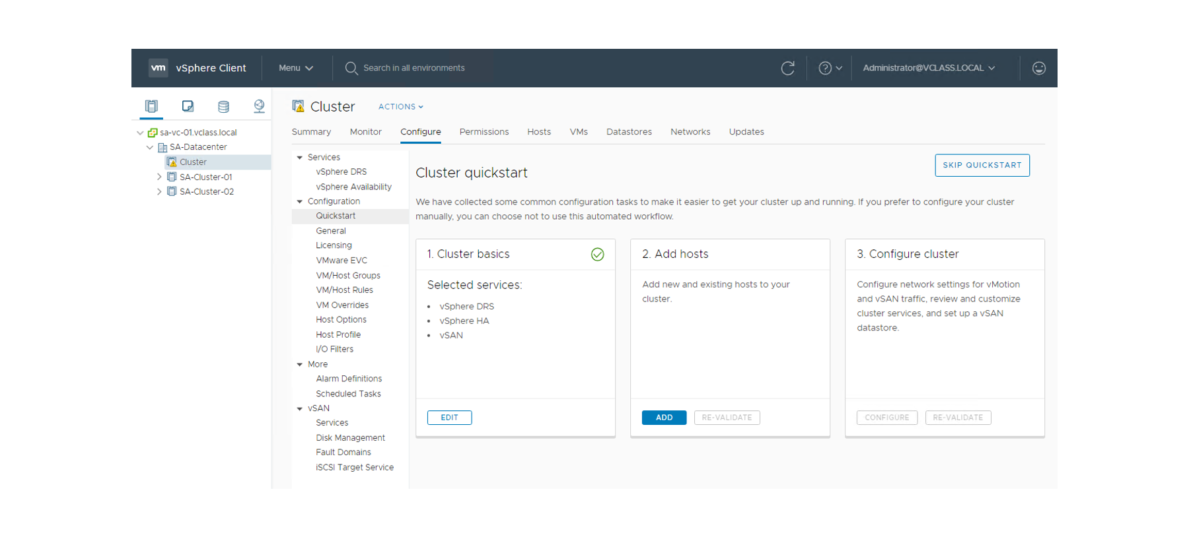
Configuring the Cluster Using Quickstart
After you create a cluster, you can use the Cluster Quickstart workflow to configure the cluster. With Cluster Quickstart, you follow a step-by-step configuration wizard that makes it easy to expand the cluster as needed.
Notes:
The Cluster Quickstart workflow guides you through the deployment process for clusters. It covers every aspect of the initial configuration, such as host, network, and vSphere settings. With Cluster Quickstart, you can also add additional hosts to a cluster as part of the ongoing expansion of clusters. Cluster Quickstart reduces the time it takes to configure a cluster.
The workflow includes the following tasks:
Setting up services such as vSphere HA and vSAN
Verifying hardware and software compatibility
Deploying Virtual Distributed Switches
Configuring network settings for vSphere vMotion and vSAN
Creating a vSAN stretched cluster or vSAN fault domains
Ensuring consistent NTP configuration across the cluster
The Cluster quickstart page provides workflow cards for configuring your new cluster:
Cluster basics: Lists the services that you have already enabled and provides an option for editing the cluster's name.
Add hosts: Adds ESXi hosts to the cluster. These hosts must already be present in the inventory. After hosts are added, the workflow shows the total number of hosts that are present in the cluster and provides health check validation for those hosts. At the start, this workflow is empty.
Configure cluster: Informs you about what can be automatically configured, provides details on configuration mismatch, and reports cluster health results through the vSAN health service even after the cluster is configured.
For more information about creating clusters, see vCenter Server and Host Management at https://docs.vmware.com/en/VMware-vSphere/7.0/com.vmware.vsphere.vcenterhost.doc/GUID-3B5AF2B1-C534-4426-B97A-D14019A8010F.html.

Slide 10
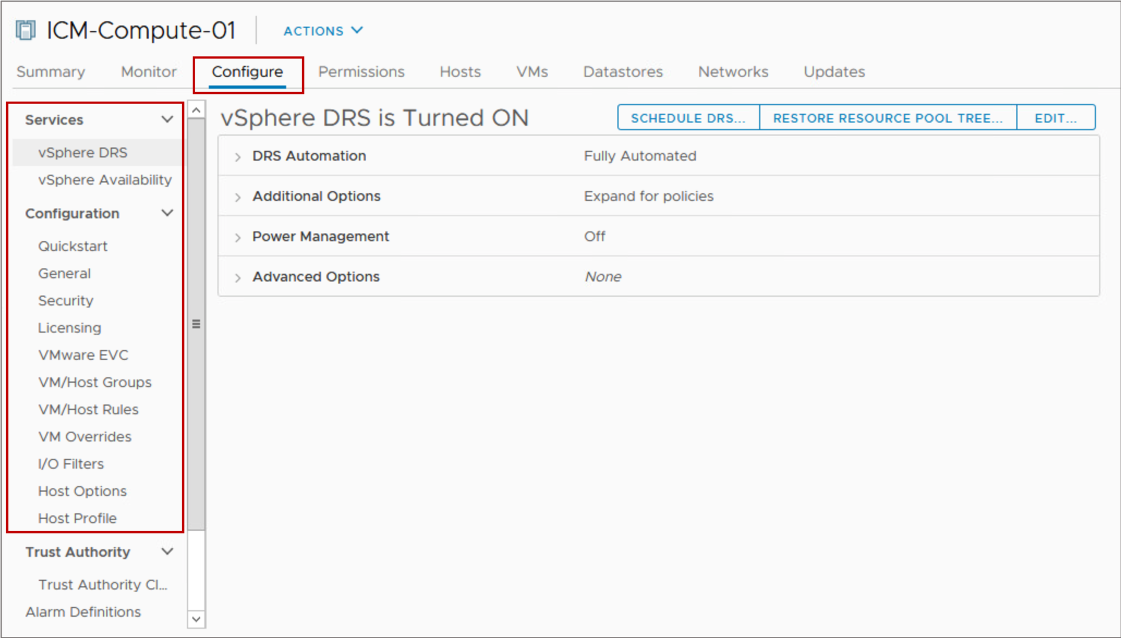
Configuring the Cluster Manually
Alternatively, you can use the Configure tab to manually configure a cluster's settings.

Slide 11
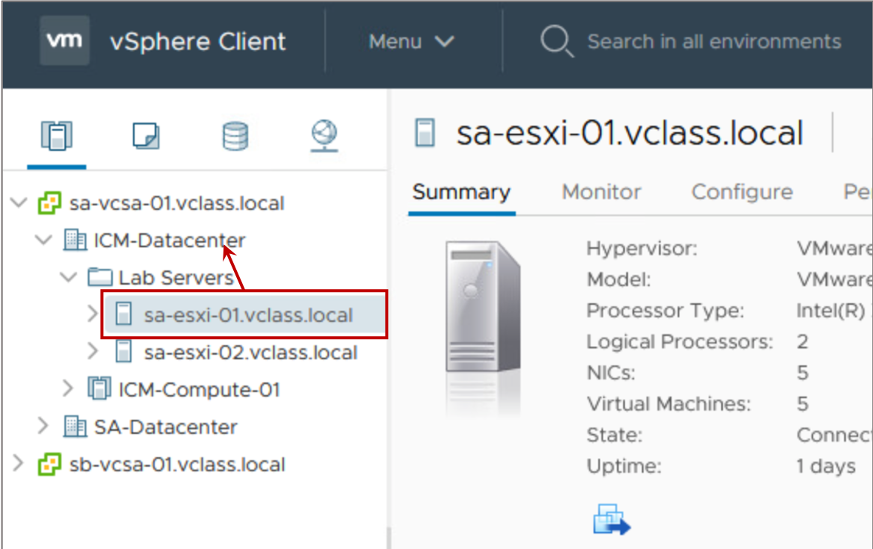
Adding a Host to a Cluster
To add a host to a cluster, drag the host onto the cluster object in the inventory.

Slide 12
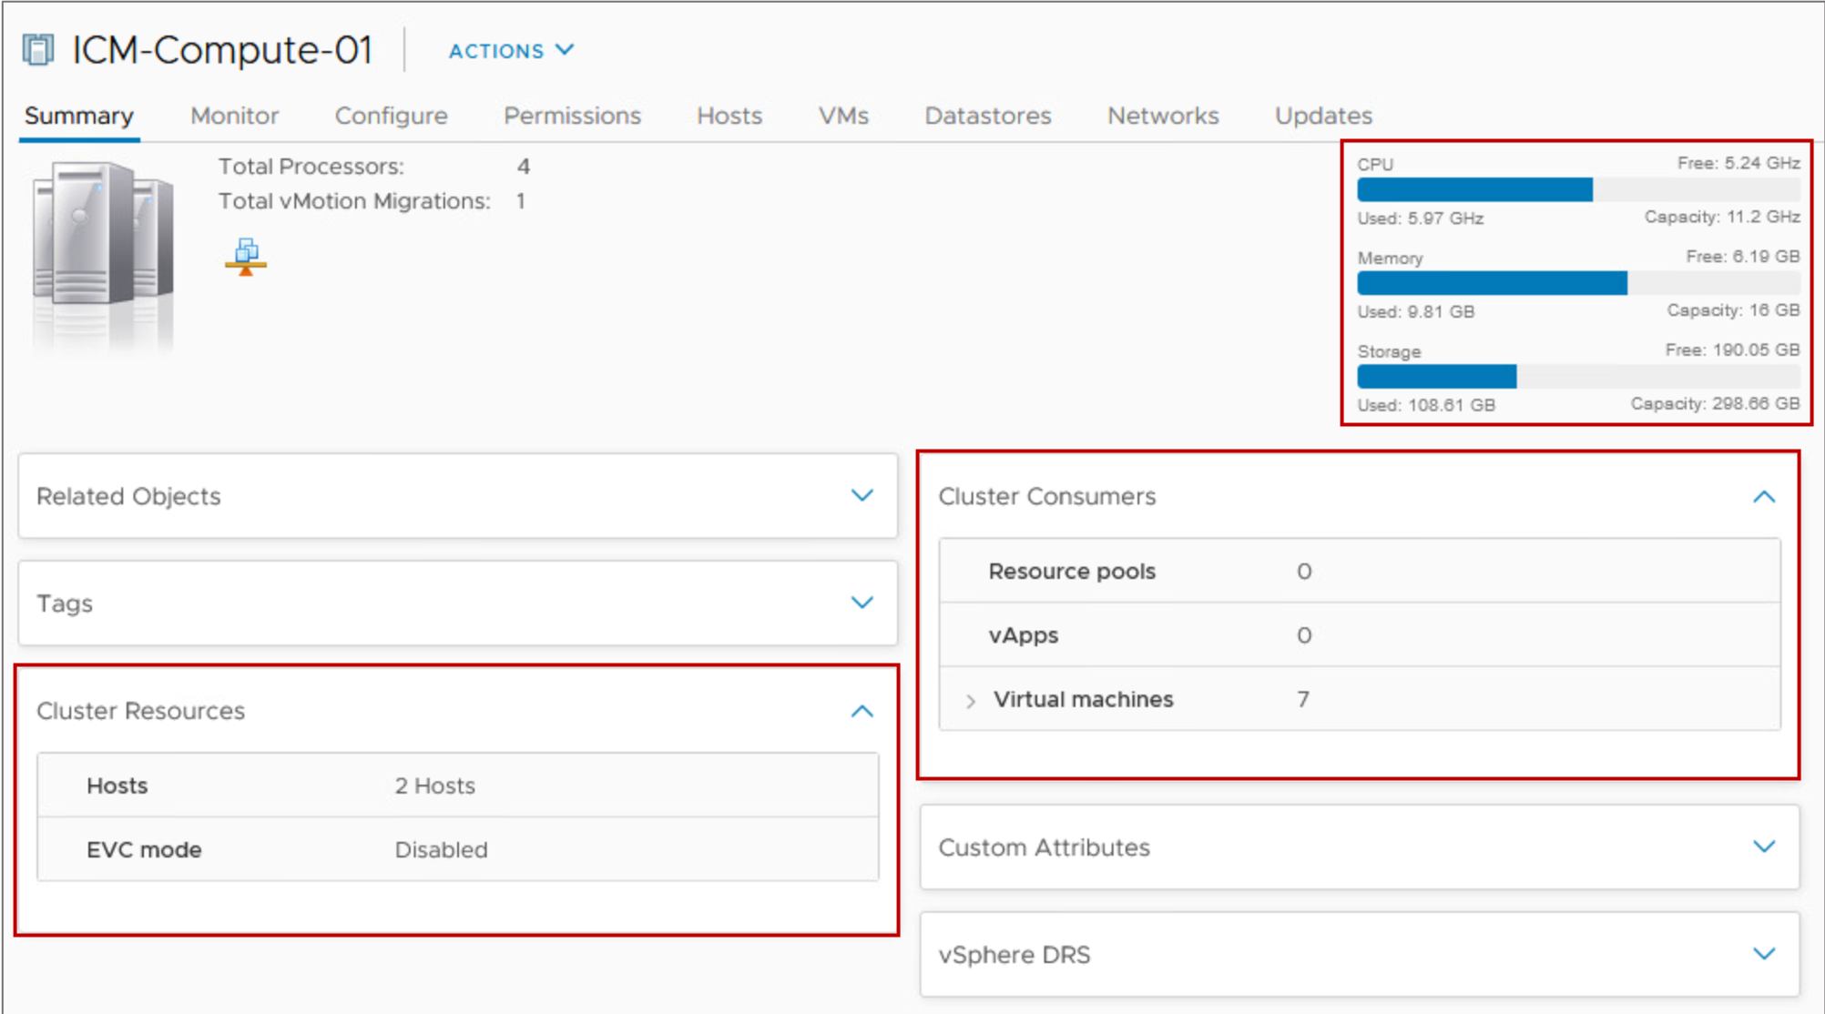
Viewing Cluster Summary Information
For a quick view of your cluster configuration, the Summary tab provides general information about a cluster's resources and its consumers.

Slide 13
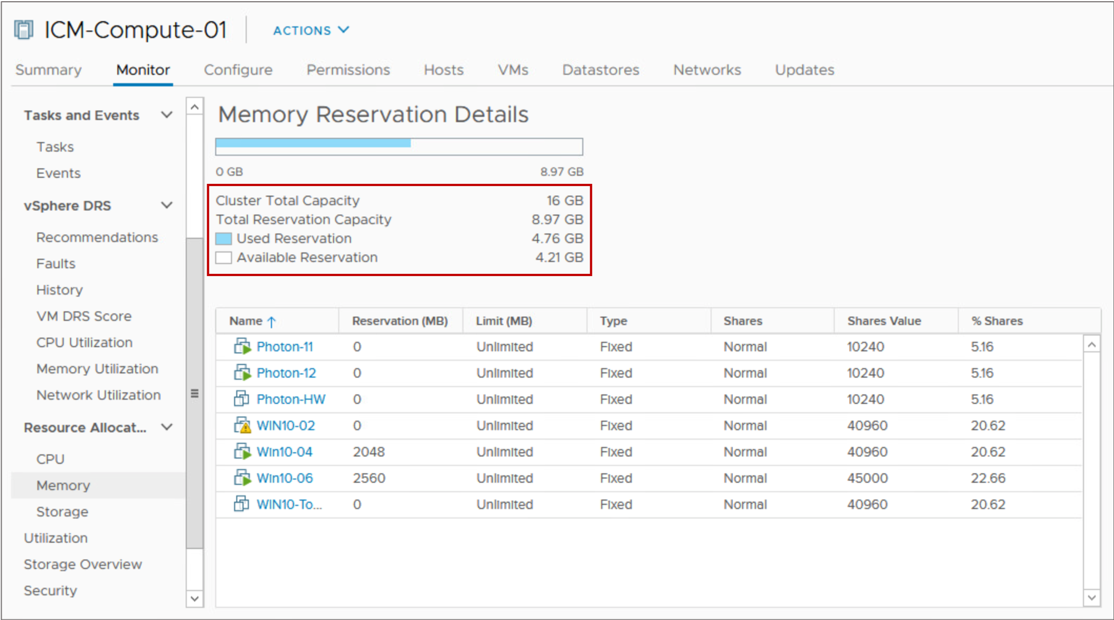
Monitoring Cluster Resources
You can view a report of total cluster CPU, memory, memory overhead, storage capacity, the capacity reserved by VMs, and how much capacity remains available.
Notes:
vCenter Server uses vSphere HA admission control to ensure that sufficient resources are available in a cluster to provide failover protection and to ensure that VM resource reservations are respected.

Slide 14
Review of Learner Objectives
After completing this lesson, you should be able to meet the following objectives:
Describe the benefits of vSphere clusters
Create a vSphere cluster
View information about a vSphere cluster

Slide 15
Lesson 2: vSphere DRS

Slide 16
Learner Objectives
After completing this lesson, you should be able to meet the following objectives:
Describe the functions of a vSphere DRS cluster
Explain how vSphere DRS determines VM placement on hosts in the cluster
Enable vSphere DRS in a cluster
Monitor a vSphere DRS cluster

Slide 17
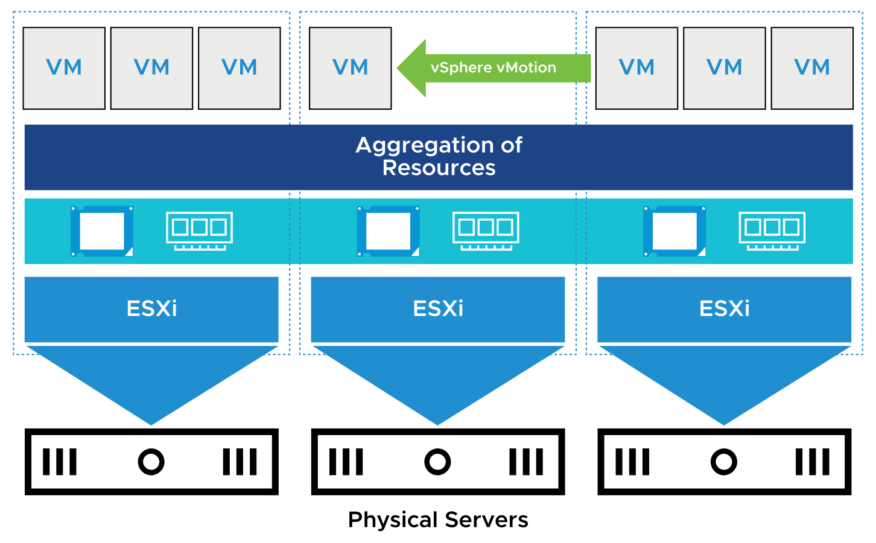
About vSphere DRS
vSphere DRS is a cluster feature that helps improve resource allocation across all hosts in a cluster. It aggregates computing capacity across a collection of servers into logical resource pools.
vSphere DRS is used in the following situations:
Initial placement of a VM when it is powered on
Load balancing
Migrating VMs when an ESXi host is placed in maintenance mode
Notes:
When you power on a VM in the cluster for the first time, vSphere DRS either places the VM on a particular host or makes a recommendation.
DRS attempts to improve resource use across the cluster by performing automatic migrations of VMs (vSphere vMotion) or by providing a recommendation for VM migrations.
Before an ESXi host enters maintenance mode, VMs running on the host must be migrated to another host (either manually or automatically by DRS) or shut down.

Slide 18
vSphere DRS: VM Focused
vSphere DRS is VM focused:
While the VM is powered on, vSphere DRS operates on an individual VM basis by ensuring that each VM's resource requirements are met.
vSphere DRS calculates a score for each VM and gives recommendations (or migrates VMs) for meeting VM's resource requirements.
Notes:
The DRS algorithm recommends where individual VMs should be moved for maximum efficiency. If the cluster is in fully automated mode, DRS executes the recommendations and migrates VMs to their optimal host based on the underlying calculations performed every minute.

Slide 19
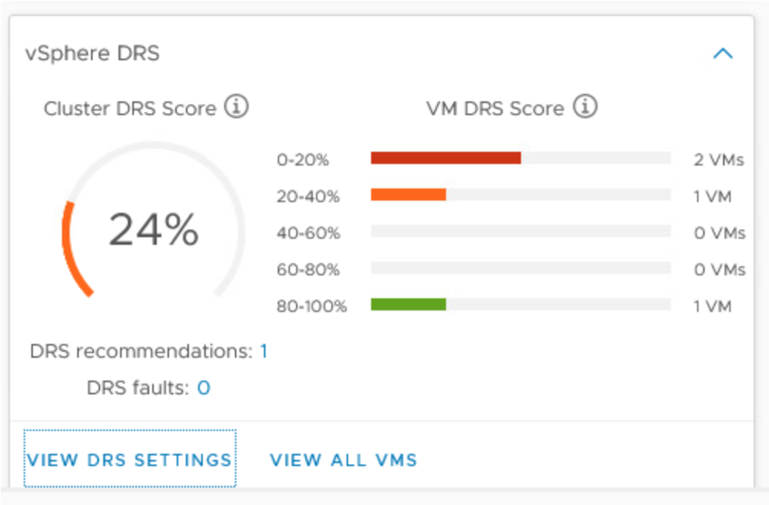
About the VM DRS Score
The VM DRS score is a metric that tracks a VM’s execution efficiency on a given host.
Execution efficiency is the frequency that the VM is reported as having its resources requirements met:
Values closer to 0% indicate severe resource contention.
Values closer to 100% indicate mild to no resource contention.
Notes:
A VM DRS score is computed from an individual VM's CPU, memory, and network metrics. DRS uses these metrics to gauge the goodness or wellness of the VM.
In vSphere 7, the DRS algorithm runs every minute. The Cluster DRS Score is the last result of DRS running and is filed into one of five buckets. These buckets are simply 20 percent ranges: 0-20, 20-40, 40-60, 60-80 and 80-100 percent over the sample period.

Slide 20
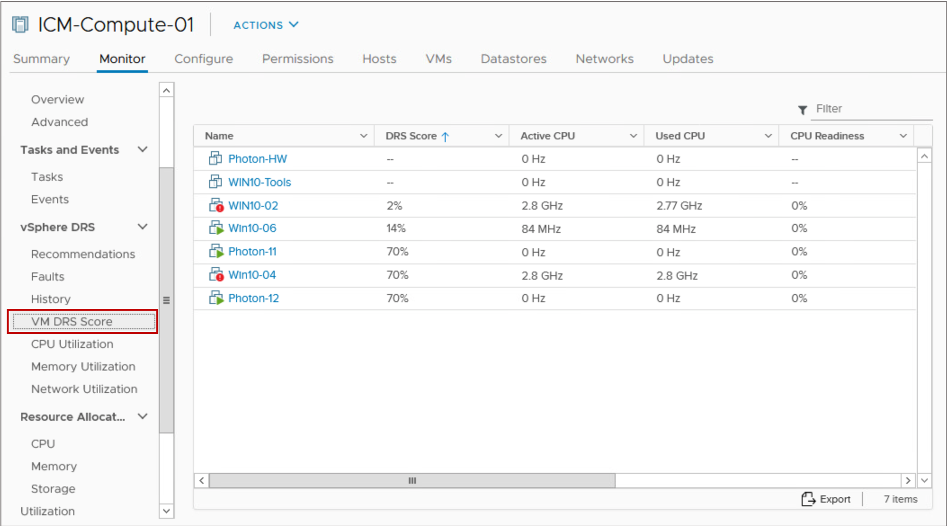
VM DRS Score List
The cluster's Monitor tab lists the VM DRS Score and more detailed metrics for all the VMs in the cluster.
Notes:
The VM DRS Score page shows the following values for VMs that are powered on:
DRS Score
Active CPU
Used CPU
CPU Readiness
Granted Memory
Swapped Memory
Ballooned Memory

Slide 21
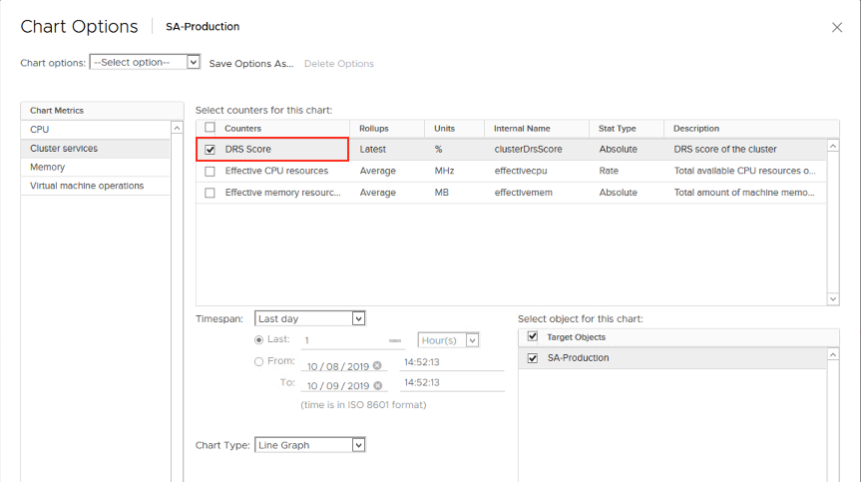
Viewing VM DRS Scores Using Performance Charts (1)
The advanced performance chart for a cluster object provides the DRS Score counter.

Slide 22
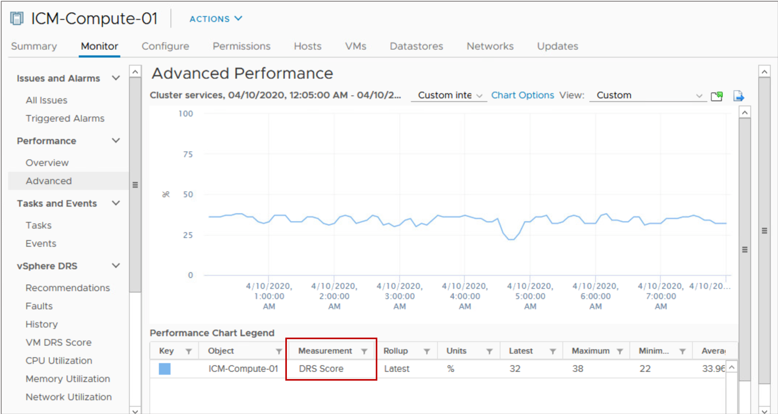
Viewing VM DRS Scores Using Performance Charts (2)
The DRS Score counter displays the DRS scores for VMs in the cluster over the selected time period.

Slide 23
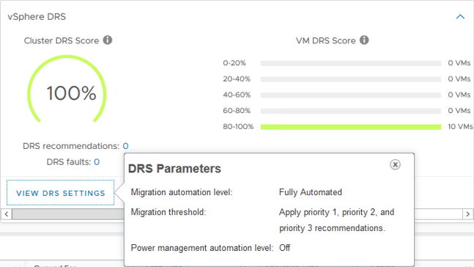
Viewing vSphere DRS Settings
When you click VIEW DRS SETTINGS, the main vSphere DRS parameters and their current values are shown.
vSphere DRS settings include:
Automation level
Migration threshold
Notes:
To view the vSphere DRS pane, go to the cluster's Summary tab.

Slide 24
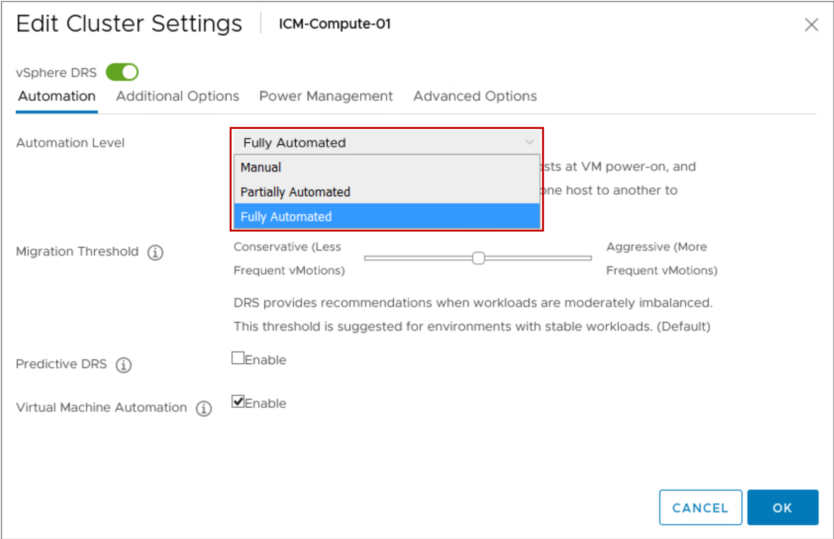
vSphere DRS Settings: Automation Level
You can configure the automation level for the initial placement of VMs and for dynamic balancing while VMs are running.
Notes:
The automation level determines whether vSphere DRS makes migration recommendations or automatically places VMs on hosts. vSphere DRS makes placement decisions when a VM powers on and when VMs must be rebalanced across hosts in the cluster.
The following automation levels are available:
Manual: When you power on a VM, vSphere DRS displays a list of recommended hosts on which to place the VM. When the cluster becomes imbalanced, vSphere DRS displays recommendations for VM migration.
Partially automated: When you power on a VM, vSphere DRS places it on the best-suited host. When the cluster becomes imbalanced, vSphere DRS displays recommendations for manual VM migration.
Fully automated: When you power on a VM, vSphere DRS places it on the best-suited host. When the cluster becomes imbalanced, vSphere DRS migrates VMs from overused hosts to underused hosts to ensure balanced use of cluster resources.

Slide 25
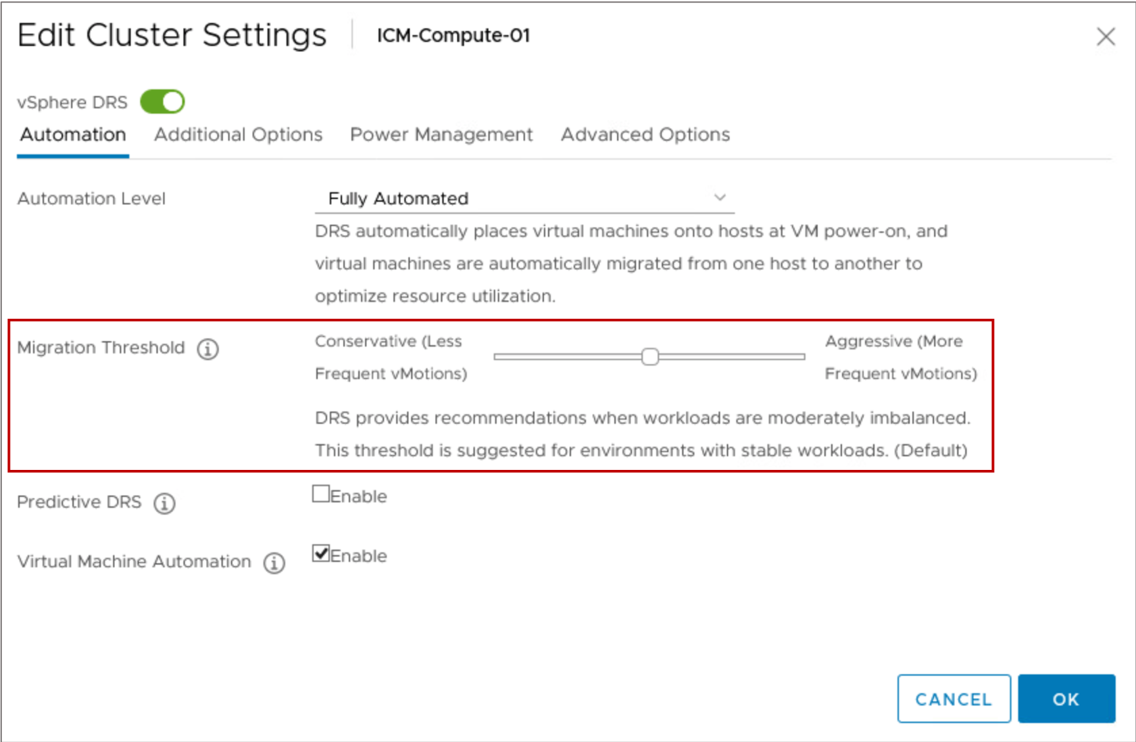
vSphere DRS Settings: Migration Threshold
The migration threshold determines how aggressively vSphere DRS selects to migrate VMs.
Notes:
The following migration threshold settings are available:
Level 1 (Conservative): Applies only priority 1 recommendations. vCenter Server applies only recommendations that must be taken to satisfy cluster constraints, such as affinity rules and host maintenance.
Level 2: Apply priority 1 and priority 2 recommendations. vCenter Server applies recommendations that promise a significant improvement to the cluster’s load balance.
Level 3 (default): Apply priority 1, priority 2, and priority 3 recommendations. vCenter Server applies recommendations that promise at least good improvement to the cluster’s load balance.
Level 4: Apply priority 1, priority 2, priority 3, and priority 4 recommendations. vCenter Server applies recommendations that promise even a moderate improvement to the cluster’s load balance.
Level 5 (Aggressive): Apply all recommendations. vCenter Server applies recommendations that promise even a slight improvement to the cluster’s load balance.

Slide 26
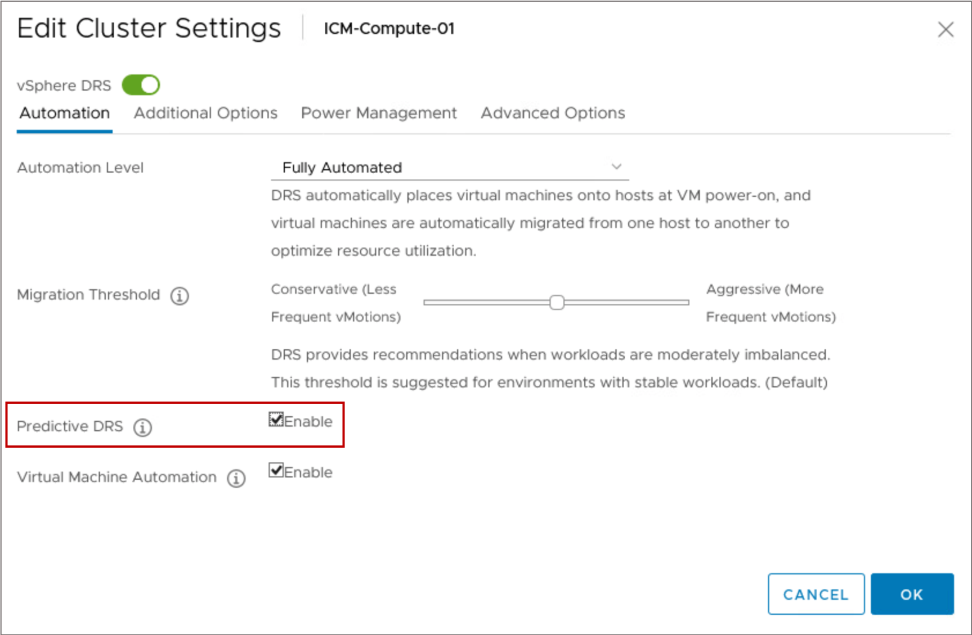
vSphere DRS Settings: Predictive DRS
vSphere DRS and vRealize Operations Manager combine data to predict future demand and determine when and where high resource utilization occurs.
To make predictive decisions, the vSphere DRS data collector retrieves the following data:
Resource usage statistics from ESXi hosts
Predicted usage statistics from the vRealize Operations Manager server
Predicted usage statistics always take precedence over current usage statistics.

Slide 27
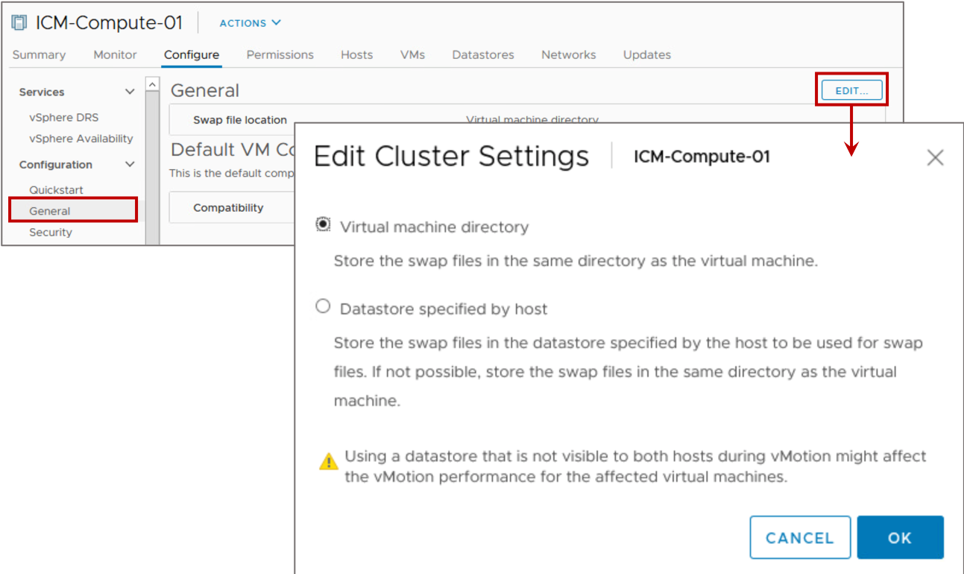
vSphere DRS Settings: VM Swap File Location
By default, swap files for a VM are on a datastore in the folder containing the other VM files.
For all VMs in the cluster, you can place VM swap files on an alternative datastore.
If vSphere DRS is enabled, you should place the VM swap file in the VM's directory.
Notes:
A VM's files can be on a VMFS datastore, an NFS datastore, a vSAN datastore, or a vSphere Virtual Volumes datastore. On a vSAN datastore or a vSphere Virtual Volumes datastore, the swap file is created as a separate vSAN or vSphere Virtual Volumes object.
A swap file is created by the ESXi host when a VM is powered on. If this file cannot be created, the VM cannot power on. Instead of accepting the default, you can also use the following options:
Use per-VM configuration options to change the datastore to another shared storage location.
Use host-local swap, which allows you to specify a datastore stored locally on the host. You can swap at a per-host level. However, it can lead to a slight degradation in performance for vSphere vMotion because pages swapped to a local swap file on the source host must be transferred across the network to the destination host. Currently, vSAN and vSphere Virtual Volumes datastores cannot be specified for host-local swap.

Slide 28
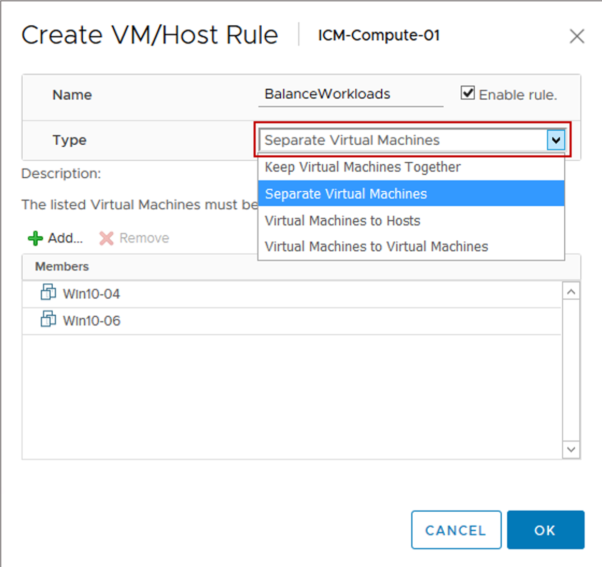
vSphere DRS Settings: VM Affinity
vSphere DRS virtual machine affinity rules specify that selected VMs be placed either on the same host (affinity) or on separate hosts (anti-affinity):
Affinity rules: Use for multi-VM systems where VMs communicate heavily with one another.
Anti-affinity rules: Use for multi-VM systems where load balancing or high availability is desired.
Notes:
After a vSphere DRS cluster is created, you can edit its properties to create rules that specify affinity. The following types of rules can be created:
Affinity rules: vSphere DRS keeps certain VMs together on the same host (for example, for performance reasons).
Anti-affinity rules: vSphere DRS ensures that certain VMs are not together (for example, for availability reasons).
If two rules conflict, you are prevented from enabling both.
When you add or edit a rule, and the cluster is immediately in violation of that rule, the cluster continues to operate and tries to correct the violation.
For vSphere DRS clusters that have a default automation level of manual or partially automated, migration recommendations are based on both rule fulfillment and load balancing.

Slide 29
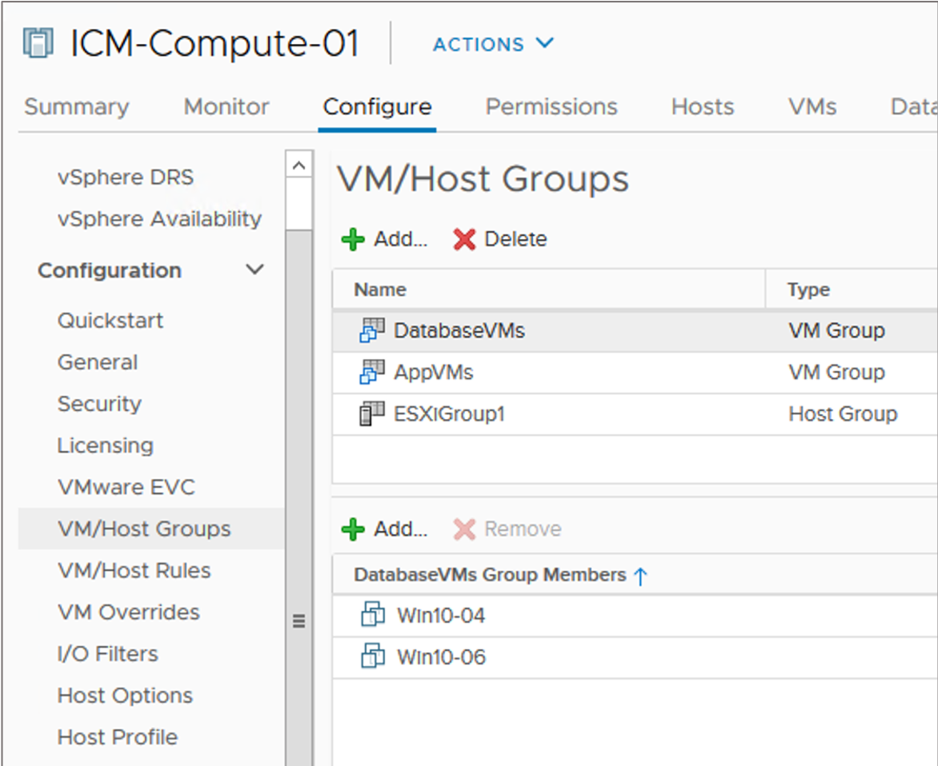
vSphere DRS Settings: DRS Groups
VM groups and host groups are used in defining VM-Host affinity rules.
The VM-Host affinity rule specifies whether VMs can or cannot be run on a host.
Types of groups:
VM group: One or more VMs
Host group: One or more ESXi hosts
A VM can belong to multiple VM groups.
A host can belong to multiple host groups.
Notes:
For ease of administration, virtual machines can be placed in VM or host groups. You can create one or more VM groups in a vSphere DRS cluster, each consisting of one or more VMs. A host group consists of one or more ESXi hosts.
The main use of VM groups and host groups is to help in defining the VM-Host affinity rules.

Slide 30
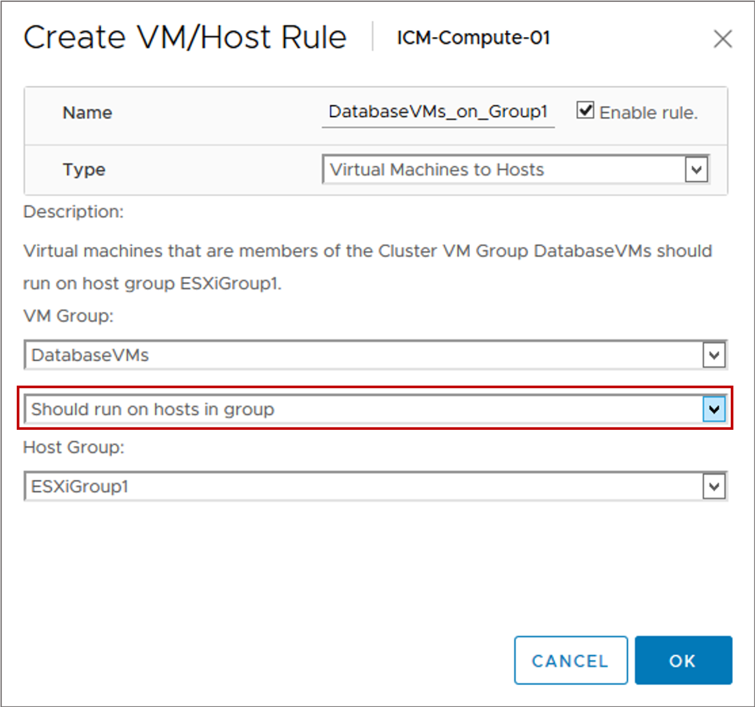
vSphere DRS Settings: VM-Host Affinity Rules
A VM-Host affinity rule:
Defines an affinity (or anti-affinity) relationship between a VM group and a host group
Is either a required rule or a preferential rule
Rule options:
Must run on hosts in group
Should run on hosts in group
Must not run on hosts in group
Should not run on hosts in group
Notes:
A VM-Host affinity or anti-affinity rule specifies whether the members of a selected VM group can run on the members of a specific host group.
Unlike an affinity rule for VMs, which specifies affinity (or anti-affinity) between individual VMs, a VM-Host affinity rule specifies an affinity relationship between a group of VMs and a group of hosts.
Because VM-Host affinity rules are cluster-based, the VMs and hosts that are included in a rule must all reside in the same cluster. If a VM is removed from the cluster, the VM loses its membership from all VM groups, even if it is later returned to the cluster.

Slide 31
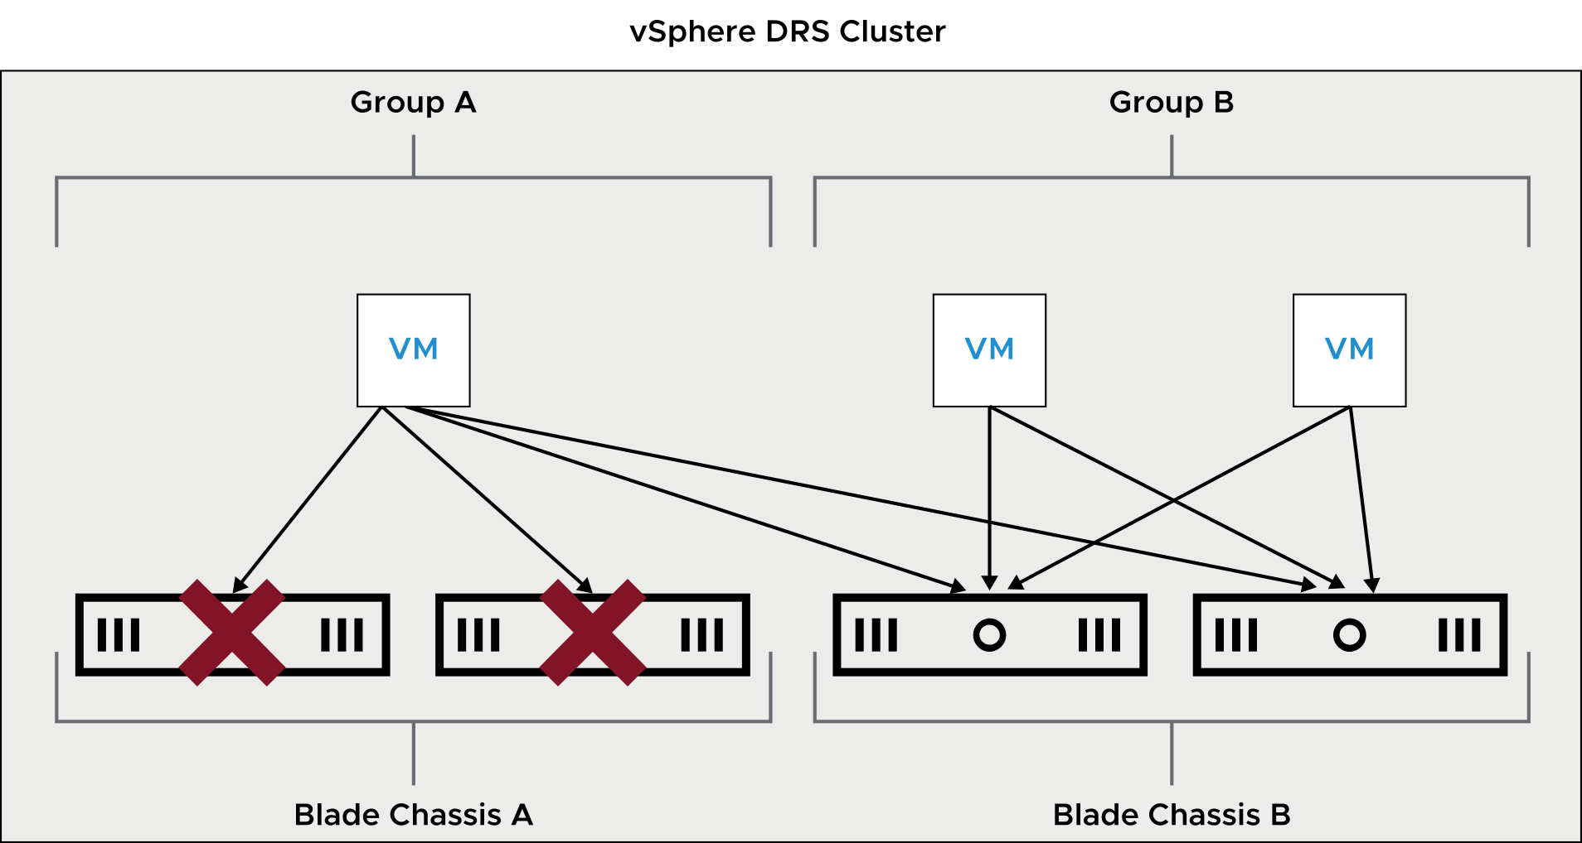
VM-Host Affinity Preferential Rules
A preferential rule is softly enforced and can be violated if necessary.
Example: Separate VMs on different blade systems for improved performance.
Notes:
Preferential rules can be violated to allow the proper functioning of vSphere DRS, vSphere HA, and VMware vSphere DPM.
On the slide, Group A and Group B are VM groups. Blade Chassis A and Blade Chassis B are host groups. The goal is to force the VMs in Group A to run on the hosts in Blade Chassis A and to force the VMs in Group B to run on the hosts in Blade Chassis B. If the hosts fail, vSphere HA restarts the VMs on the other hosts in the cluster. If the hosts are put into maintenance mode or become overused, vSphere DRS moves the VMs to the other hosts in the cluster.

Slide 32
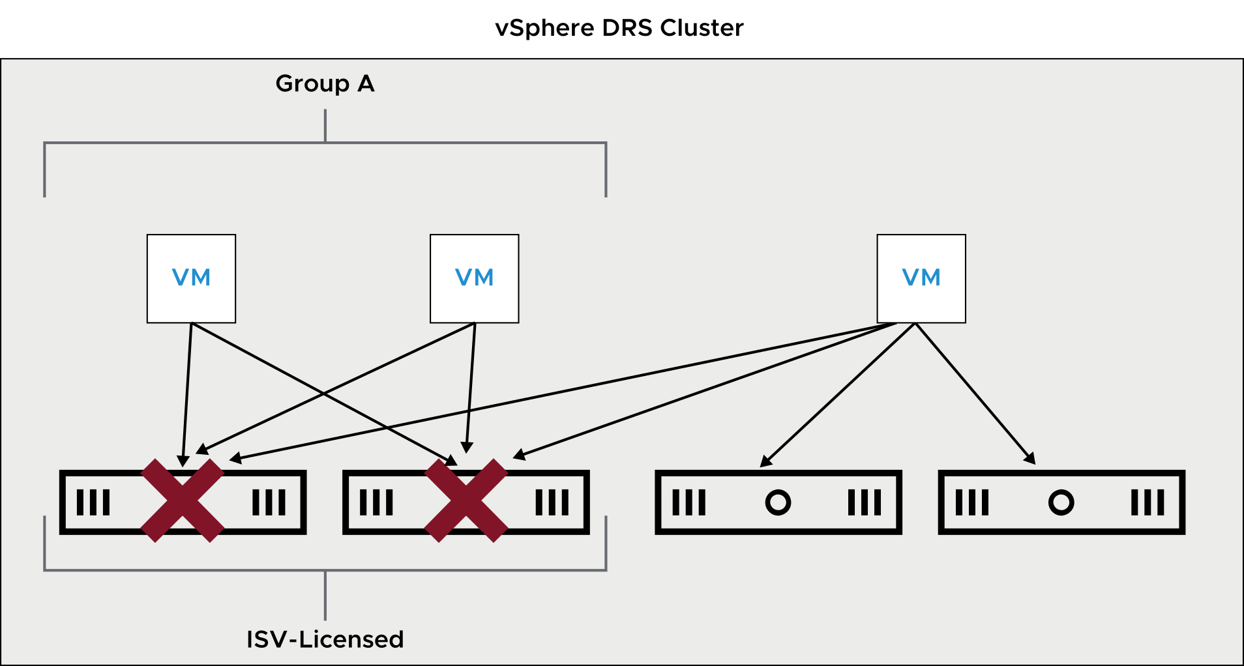
VM-Host Affinity Required Rules
A required rule is strictly enforced and can never be violated.
Example: Enforce host-based ISV licensing.
Notes:
A VM-Host affinity rule that is required, instead of preferential, can be used when the software running in your VMs has licensing restrictions. You can enforce this rule when the software running in your VMs has licensing restrictions. You can place such VMs in a VM group. Then you can create a rule that requires the VMs to run on a host group, which contains hosts with the required licenses.
When you create a VM-Host affinity rule that is based on the licensing or hardware requirements of the software running in your VMs, you are responsible for ensuring that the groups are properly set up. The rule does not monitor the software running in the VMs. Nor does it know which third-party licenses are in place on which ESXi hosts.
On the slide, Group A is a VM group. You can force Group A to run on hosts in the ISV-Licensed group to ensure that the VMs in Group A run on hosts that have the required licenses. But if the hosts in the ISV-Licensed group fail, vSphere HA cannot restart the VMs in Group A on hosts that are not in the group. If the hosts in the ISV-Licensed group are put into maintenance mode or become overused, vSphere DRS cannot move the VMs in Group A to hosts that are not in the group.

Slide 33
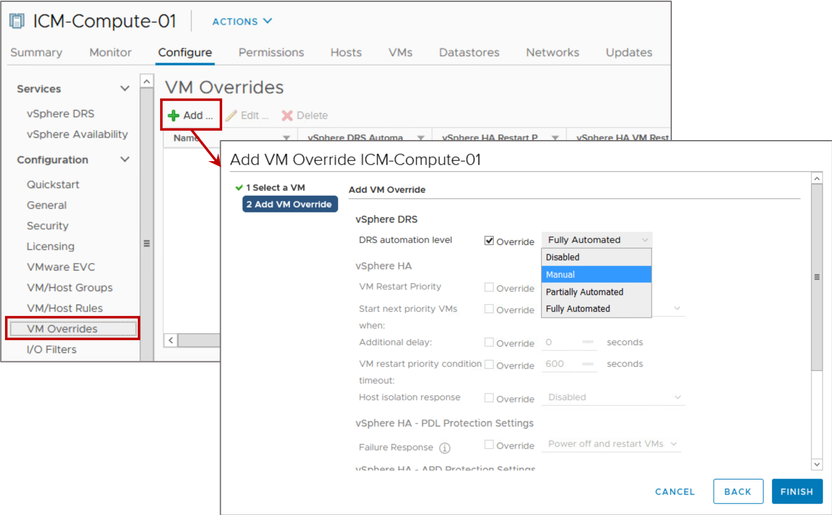
vSphere DRS Settings: VM-Level Automation
You can customize the automation level for individual VMs in a cluster to override the automation level set on the entire cluster.
Notes:
By setting the automation level for individual VMs, you can fine-tune automation to suit your needs. For example, you might have a VM that is especially critical to your business. You want more control over its placement so you set its automation level to Manual. If a VM’s automation level is set to disabled, vCenter Server does not migrate that VM or provide migration recommendations for it.
As a best practice, enable automation. Select the automation level based on your environment and level of comfort. For example, if you are new to vSphere DRS clusters, you might select Partially Automated because you want control over the movement of VMs. When you are comfortable with what vSphere DRS does and how it works, you might set the automation level to Fully Automated. You can set the automation level to Manual on VMs over which you want more control, such as your business-critical VMs.

Slide 34
vSphere DRS Cluster Requirements
ESXi hosts that are added to a vSphere DRS cluster must meet certain requirements to use cluster features successfully:
To use vSphere DRS for load balancing, the hosts in your cluster must be part of a vSphere vMotion network:
If the hosts are not part of a vSphere vMotion network, vSphere DRS can still make initial placement recommendations.
vSphere DRS works best if the VMs meet vSphere vMotion requirements.
Configure all managed hosts to use shared storage.
Notes:
You can create vSphere DRS clusters, or you can enable vSphere DRS for existing vSphere HA or vSAN clusters.

Slide 35
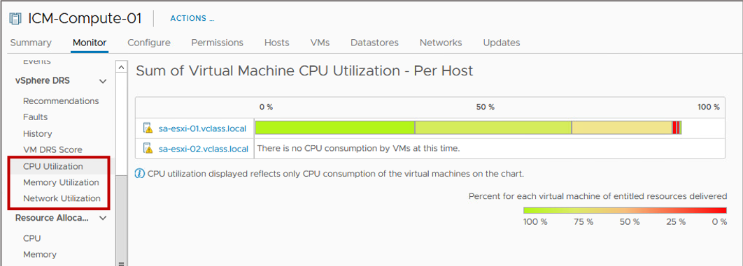
Viewing vSphere DRS Cluster Resource Utilization
From the cluster's Monitor tab, you can view CPU, memory, and network utilization per host.
Notes:
The CPU Utilization and Memory Utilization charts show all the hosts in the cluster and how their CPU and memory resources are allocated to each VM.
For CPU usage, the VM information is represented by a colored box. If you point to the colored box, the VM’s CPU usage information appears. If the VM is receiving the resources that it is entitled to, the box is green. Green means that 100 percent of the VM’s entitled resources are delivered. If the box is not green (for example, entitled resources are 80 percent or less) for an extended time, you might want to investigate what is causing this shortfall (for example, unapplied recommendations).
For memory usage, the VM boxes are not color-coded because the relationship between consumed memory and entitlement is often not easily categorized.
In the Network Utilization chart, the displayed network data reflects all traffic across physical network interfaces on the host.

Slide 36
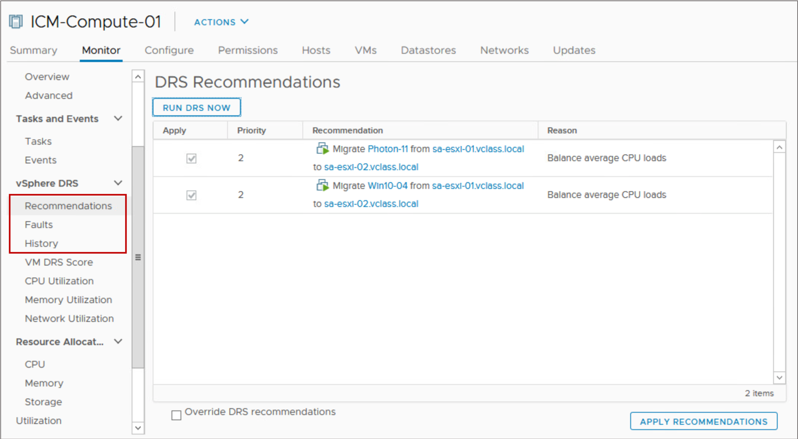
Viewing vSphere DRS Recommendations
The DRS Recommendations pane displays information about the vSphere DRS recommendations made for the cluster.
You can also view the faults that occurred when the recommendations were applied and the history of vSphere DRS actions.
Notes:
In the DRS Recommendations pane, you can see the current set of recommendations that are generated for optimizing resource use in the cluster through either migrations or power management. Only manual recommendations awaiting user confirmation appear in the list.
To refresh the recommendations, click RUN DRS NOW.
To apply all recommendations, click APPLY RECOMMENDATIONS.
To apply a subset of the recommendations, select the Override DRS recommendations check box. Select the check box next to each desired recommendation and click APPLY RECOMMENDATIONS.

Slide 37
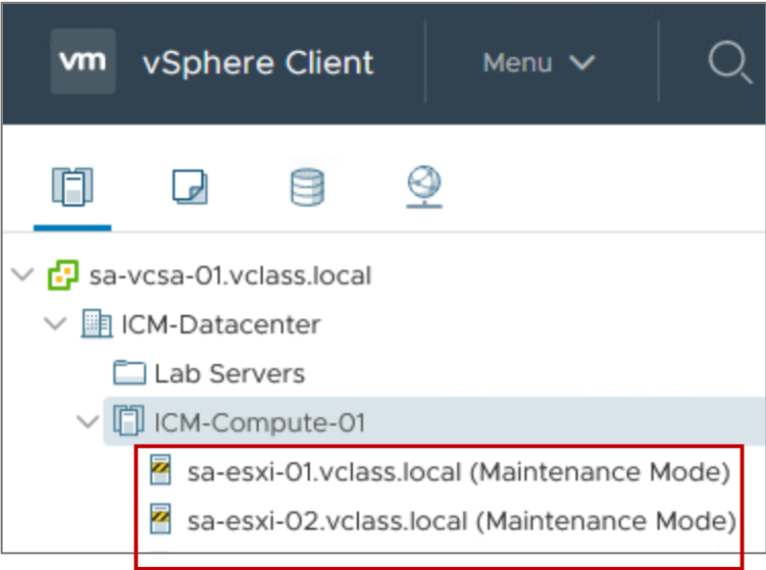
Maintenance Mode and Standby Mode
Maintenance mode:
Removes a host's resources from a cluster, making those resources unavailable for use
Is often used to service a host in a cluster
To place a host in maintenance mode:
All running VMs on the host must be migrated to another host, shut down or suspended.
When DRS is in fully automated mode, powered-on VMs are automatically migrated from a host that is placed in maintenance mode.
Standby mode:
Is used by vSphere DPM to optimize power usage. When a host is placed in standby mode, it is powered off.
Notes:
A host enters or leaves maintenance mode as the result of a user request. While in maintenance mode, the host does not allow you to deploy or power on a VM.
VMs that are running on a host entering maintenance mode must be shut down or migrated to another host, either manually (by a user) or automatically (by vSphere DRS). The host continues to run the Enter Maintenance Mode task until all VMs are powered down or moved away.
When no more running VMs are on the host, the host’s icon indicates that it has entered maintenance mode. The host’s Summary tab indicates the new state.
Place a host in maintenance mode before servicing the host, for example, when installing more memory or removing a host from a cluster.
You can place a host in standby mode manually. However, the next time that vSphere DRS runs, it might undo your change or recommend that you undo the changes. If you want a host to remain powered off, place it in maintenance mode and turn it off.

Slide 38
Removing a Host from the vSphere DRS Cluster
To remove a host from a cluster:
Place the host in maintenance mode.
Drag the host to a different inventory location, for example, the data center or another cluster.
The resources available for the cluster decrease.
Notes:
When a host is put into maintenance mode, all its running VMs must be shut down, suspended, or migrated to other hosts by using vSphere vMotion. VMs with disks on local storage must be powered off, suspended, or migrated to another host and datastore. When you remove the host from the cluster, the VMs that are currently associated with the host are also removed from the cluster. If the cluster still has enough resources to satisfy the reservations of all VMs in the cluster, the cluster adjusts resource allocation to reflect the reduced amount of resources.

Slide 39
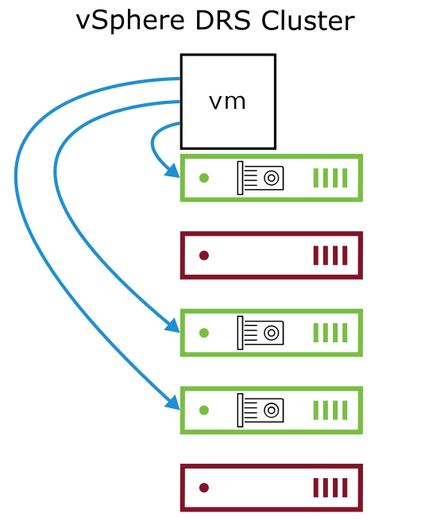
vSphere DRS and Dynamic DirectPath I/O
Dynamic DirectPath I/O improves the vSphere DirectPath I/O functionality by adding a layer of abstraction between a VM and the physical PCI device:
A pool of PCI devices that are available in the cluster can be assigned to the VM.
vSphere DRS is aware of Dynamic DirectPath I/O devices:
When the VM is powered on, vSphere DRS places the VM on any ESXi host that provides the assigned PCI device.
vSphere DRS takes action only at VM power on and does not perform any load-balancing actions.
Notes:
Dynamic DirectPath I/O is useful on hosts that have PCI passthrough devices and for virtualized devices that require a directly assigned hardware device to back it.
Dynamic DirectPath I/O is also called assignable hardware. The following devices can use assignable hardware:
PCI passthrough devices
Shared PCI passthrough devices, for example, NVIDIA GRID vGPUs
Full memory reservation is applied to the VMs with pass-through devices.

Slide 40
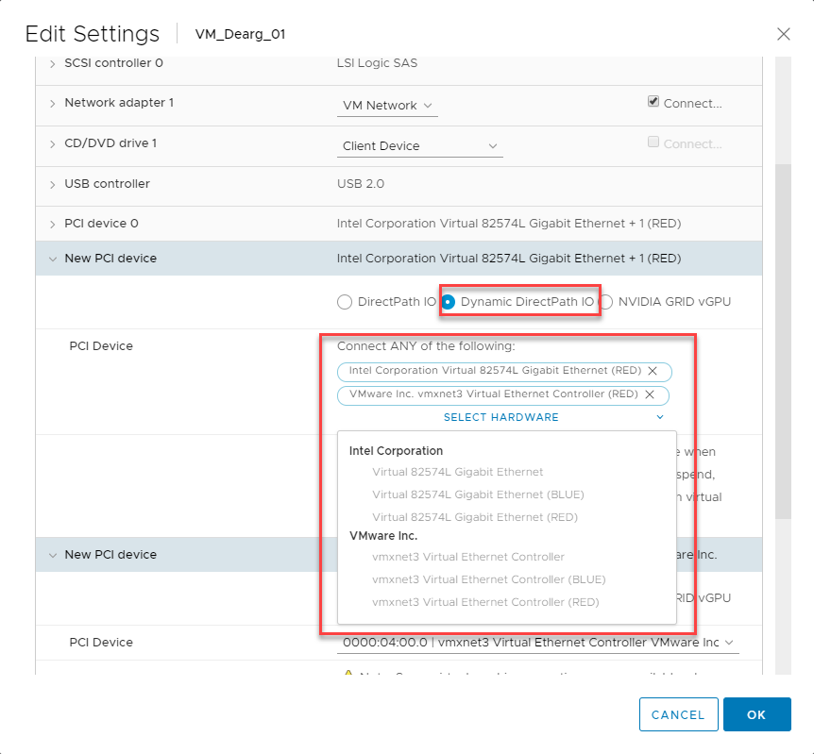
Adding a Dynamic DirectPath I/O Device to a VM
You can add Dynamic DirectPath I/O devices to a VM by editing the VM's settings.
Notes:
For New PCI device, click Dynamic DirectPath IO. Clicking SELECT HARDWARE displays a list of devices that can be attached to the VM. You can select one or more devices from the list. In the image, the VM can use either an Intel NIC with the RED hardware label or vmxnet3 NIC with the RED hardware label.

Slide 41
Lab 25: Implementing vSphere DRS Clusters
Implement a vSphere DRS cluster and verify proper functionality:
Create a Cluster That Is Enabled for vSphere DRS
Modify vSphere DRS Settings
Add ESXi Hosts to the Cluster
Verify vSphere vMotion Configuration on the ESXi Hosts
Create a Load Imbalance
Verify Proper vSphere DRS Cluster Functionality

Slide 42
Review of Learner Objectives
After completing this lesson, you should be able to meet the following objectives:
Describe the functions of a vSphere DRS cluster
Explain how vSphere DRS determines VM placement on hosts in the cluster
Enable vSphere DRS in a cluster
Monitor a vSphere DRS cluster

Slide 43
Lesson 3: Introduction to vSphere HA

Slide 44
Learner Objectives
After completing this lesson, you should be able to meet the following objectives:
Identify options for configuring a highly available vSphere environment
Describe how vSphere HA responds when an ESXi host, a virtual machine, or an application fails

Slide 45
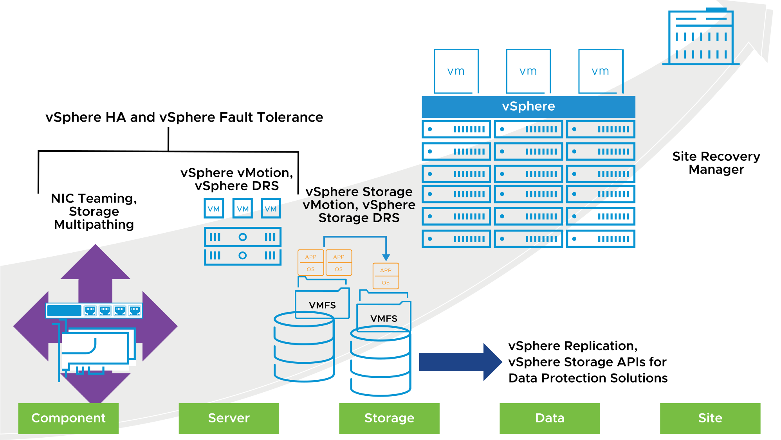
Protection at Every Level
With vSphere, you can reduce planned downtime, prevent unplanned downtime, and recover rapidly from outages.
Notes:
Whether planned or unplanned, downtime brings with it considerable costs. However, solutions to ensure higher levels of availability are traditionally costly, hard to implement, and difficult to manage.
VMware software makes it simpler and less expensive to provide higher levels of availability for important applications. With vSphere, organizations can easily increase the baseline level of availability provided for all applications and provide higher levels of availability more easily and cost effectively. With vSphere, you can:
Provide higher availability independent of hardware, operating system, and applications.
Reduce planned downtime for common maintenance operations.
Provide automatic recovery in cases of failure.
vSphere HA provides a base level of protection for your VMs by restarting VMs if a host fails. vSphere Fault Tolerance provides a higher level of availability, allowing users to protect any VM from a host failure with no loss of data, transactions, or connections. vSphere Fault Tolerance provides continuous availability by ensuring that the states of the primary and secondary VMs are identical at any point in the instruction execution of the VM.
vSphere vMotion and vSphere Storage vMotion keep VMs available during a planned outage, for example, when hosts or storage must be taken offline for maintenance. System recovery from unexpected storage failures is simple, quick, and reliable with the encapsulation property of VMs. You can use vSphere Storage vMotion to support planned storage outages resulting from upgrades to storage arrays to newer firmware or technology and VMFS upgrades.
With vSphere Replication, a vSphere platform can protect VMs natively by copying their disk files to another location where they are ready to be recovered.
VM encapsulation is used by third-party backup applications that support file and image-level backups using vSphere Storage APIs - Data Protection. Backup solutions play prominent roles in recovering from deleted files or disks and corrupt or infected guest operating systems or file systems.
With Site Recovery Manager, you can quickly restore your organization’s IT infrastructure, shortening the time that you experience a business outage. Site Recovery Manager automates setup, failover, and testing of disaster recovery plans. Site Recovery Manager requires that you install vCenter Server at the protected site and at the recovery site. Site Recovery Manager also requires either host-based replication through vSphere Replication or preconfigured array-based replication between the protected site and the recovery site.

Slide 46
About vSphere HA
vSphere HA provides rapid recovery from outages and cost-effective high availability for applications running in VMs. vSphere HA protects application availability in several ways.
Protects Against | How Does vSphere HA Provide Protection?
ESXi host failure | By restarting the VMs on other hosts within the cluster
VM failure | By restarting the VM when a VMware Tools heartbeat is not received within a set time
Application failure | By restarting the VM when an application heartbeat is not received within a set time
Datastore accessibility failure | By restarting the affected VMs on other hosts that still can access the datastores.
Network isolation | By restarting VMs if their host becomes isolated on the management or vSAN network. This protection is provided even if the network becomes partitioned.
Notes:
Unlike other clustering solutions, vSphere HA protects all workloads by using the infrastructure itself. After you configure vSphere HA, no actions are required to protect new VMs. All workloads are automatically protected by vSphere HA.

Slide 47
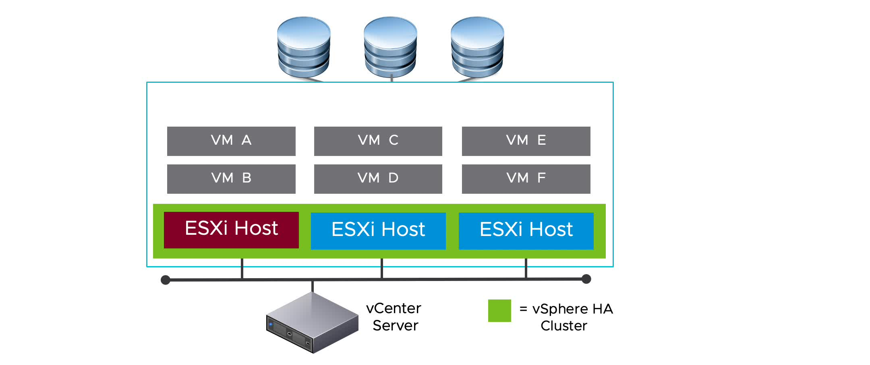
vSphere HA Scenario: ESXi Host Failure
When a host fails, vSphere HA restarts the impacted VMs on other hosts in the cluster.
Notes:
To play the animation, go to https://vmware.bravais.com/s/kvK76lswrsbmJq8kRueo.
vSphere HA can also determine whether a ESXi host is isolated or has failed. If an ESXi host fails, vSphere HA attempts to restart any VMs that were running on the failed host by using one of the remaining hosts in the cluster.
In every cluster, the time to recover depends on how long it takes your guest operating systems and applications to restart when the VM is failed over.

Slide 48
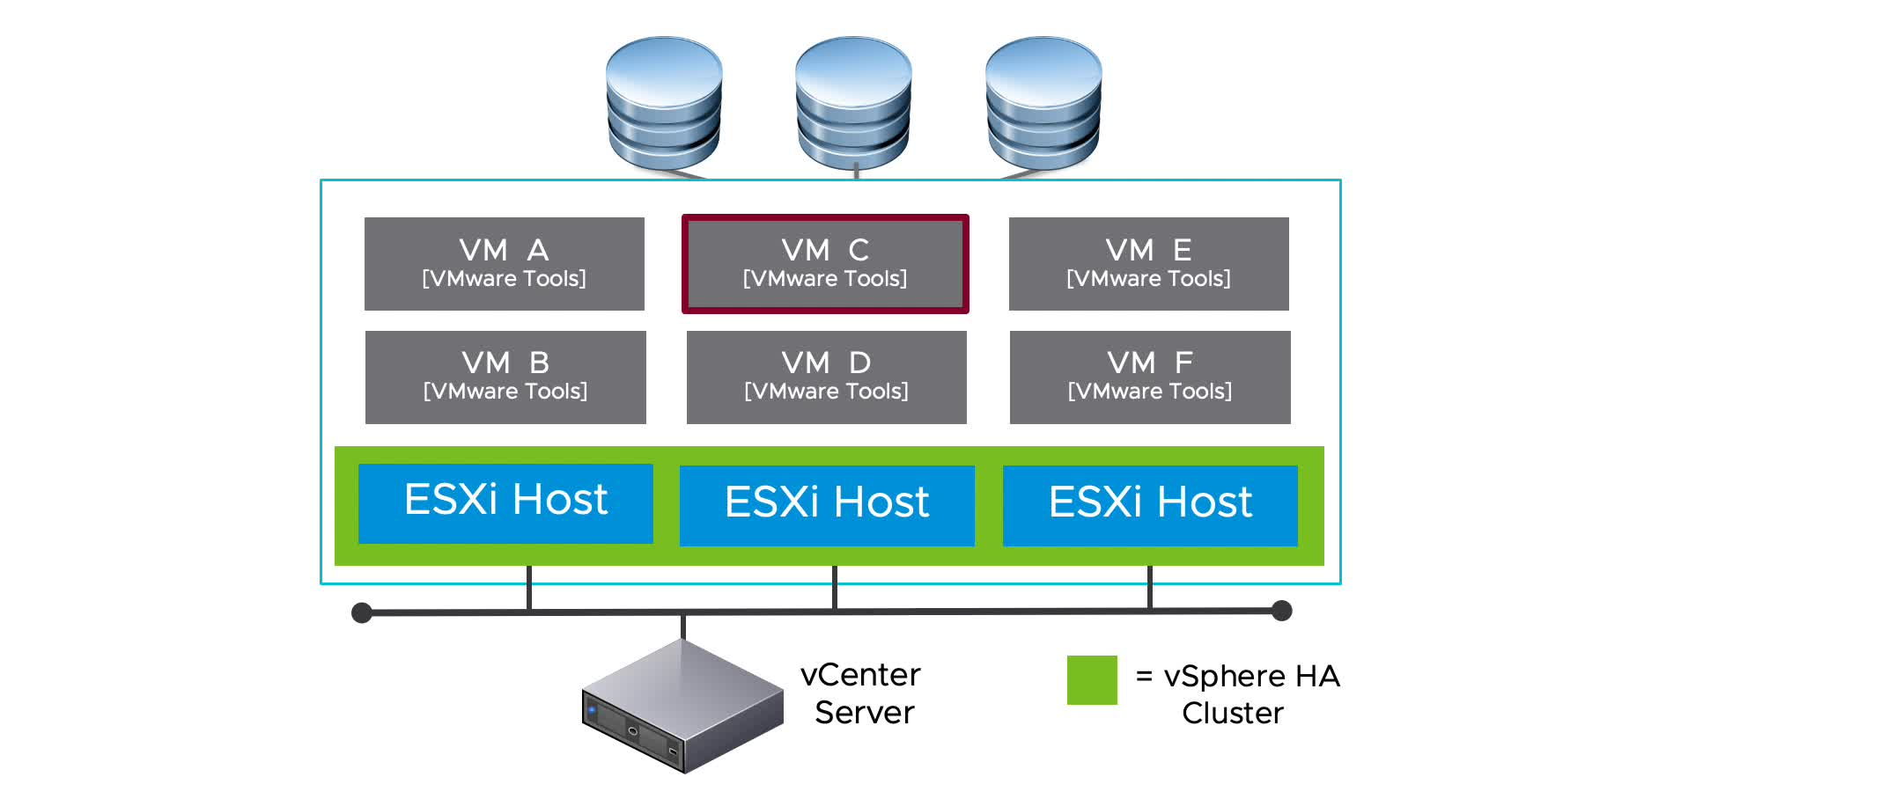
vSphere HA Scenario: Guest Operating System Failure
When a VM stops sending heartbeats or the VM process (vmx) fails unexpectedly, vSphere HA resets the VM.
Notes:
To play the animation, go to https://vmware.bravais.com/s/ikio4LtOkS6fPivIJpR6.
If VM monitoring is enabled, the vSphere HA agent on each individual host monitors VMware Tools in each VM running on the host. When a VM stops sending heartbeats, the guest operating system is reset. The VM stays on the same host.

Slide 49
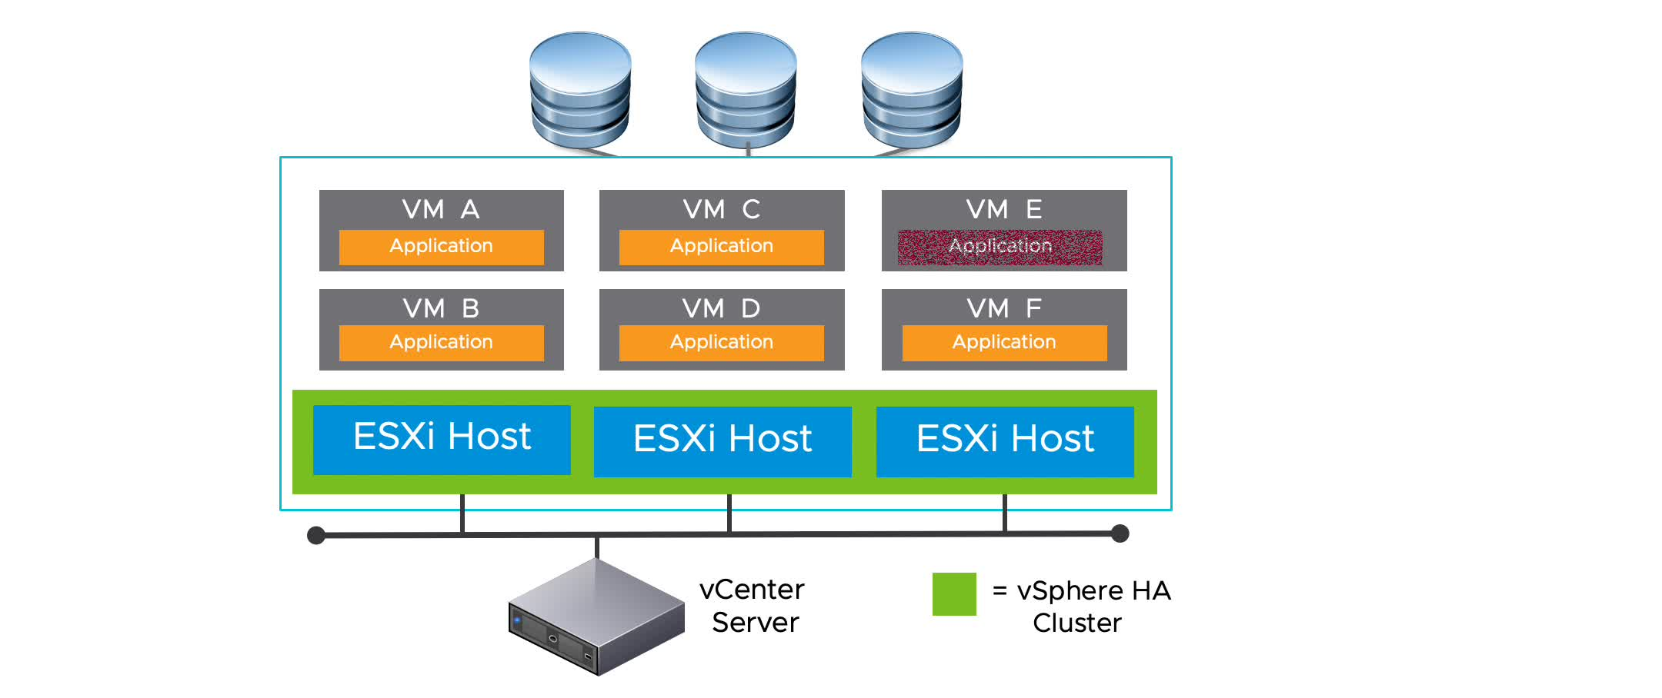
vSphere HA Scenario: Application Failure
When an application fails, vSphere HA restarts the impacted VM on the same host.
Notes:
To play the animation, go to https://vmware.bravais.com/s/OgIz03mC2MiGVVPKCxdh.
The agent on each host can optionally monitor heartbeats of applications running in each VM. When an application fails, the VM on which the application was running is restarted on the same host. Application monitoring requires a third-party application monitoring agent designed to work with VM application monitoring.

Slide 50
vSphere HA Scenario: Datastore Accessibility Failures
If VM Component Protection (VMCP) is enabled, vSphere HA can detect datastore accessibility failures and provide automated recovery for affected VMs.
You can determine the response that vSphere HA makes to such a failure, ranging from the creation of event alarms to VM restarts on other hosts:
All paths down (APD):
Recoverable.
Represents a transient or unknown accessibility loss.
Response can be either Issue events, Power off and restart VMs - Conservative restart policy, or Power off and restart VMs - Aggressive restart policy.
Permanent device loss (PDL):
Unrecoverable loss of accessibility.
Occurs when a storage device reports that the datastore is no longer accessible by the host.
Response can be either Issue events or Power off and restart VMs.
Notes:
Power off and restart VMs - Conservative restart policy: vSphere HA does not attempt to restart the affected VMs unless vSphere HA determines that another host can restart the VMs. The host experiencing the all paths down (APD) communicates with the vSphere HA master host to determine whether the cluster has sufficient capacity to power on the affected VMs. If the master host determines that sufficient capacity is available, the host experiencing the APD stops the VMs so that the VMs can be restarted on a healthy host. If the host experiencing the APD cannot communicate with the master host, no action is taken.
Power off and restart VMs - Aggressive restart policy: vSphere HA stops the affected VMs even if it cannot determine that another host can restart the VMs. The host experiencing the APD attempts to communicate with the master host to determine whether the cluster has sufficient capacity to power on the affected VMs. If the master host is not reachable, sufficient capacity to restart the VMs is unknown. In this scenario, the host takes the risk and stops the VMs so they can be restarted on the remaining healthy hosts. However, if sufficient capacity is not available, vSphere HA might not be able to recover all the affected VMs. This result is common in a network partition scenario where a host cannot communicate with the master host to get a definitive response to the likelihood of a successful recovery.

Slide 51
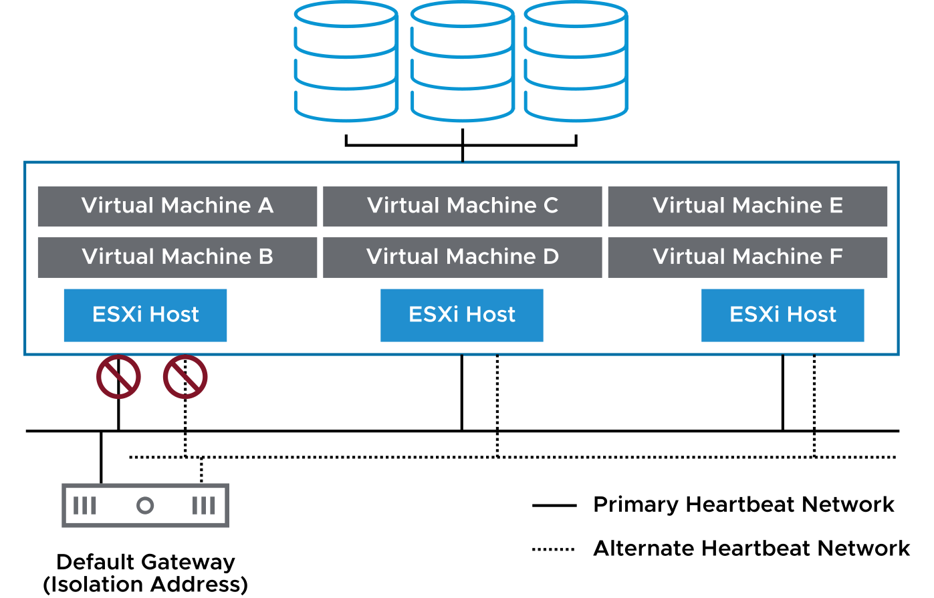
vSphere HA Scenario: Protecting VMs Against Network Isolation
vSphere HA restarts VMs if their host becomes isolated on the management or vSAN network.
Host network isolation occurs when a host is still running, but it can no longer observe traffic from vSphere HA agents on the management network:
The host tries to ping the isolation addresses. An isolation address is an IP address or FQDN that can be manually specified (the default is the host's default gateway).
If pinging fails, the host declares that it is isolated from the network.
This protection is provided even if the network becomes partitioned.
Notes:
If you ensure that the network infrastructure is sufficiently redundant and that at least one network path is always available, host network isolation is less likely to occur.

Slide 52
Importance of Redundant Heartbeat Networks
Redundant heartbeat networks ensure reliable failure detection and minimize the chance of host-isolation scenarios.
In a vSphere HA cluster, heartbeats have the following characteristics:
They are sent between the master host and the subordinate hosts.
They are used to determine whether a master host or a subordinate host has failed.
They are sent over a heartbeat network.
Notes:
Redundant heartbeat networking is the best approach for your vSphere HA cluster. When a master host’s connection fails, a second connection is still available to send heartbeats to other hosts. If you do not provide redundancy, your failover setup has a single point of failure.

Slide 53
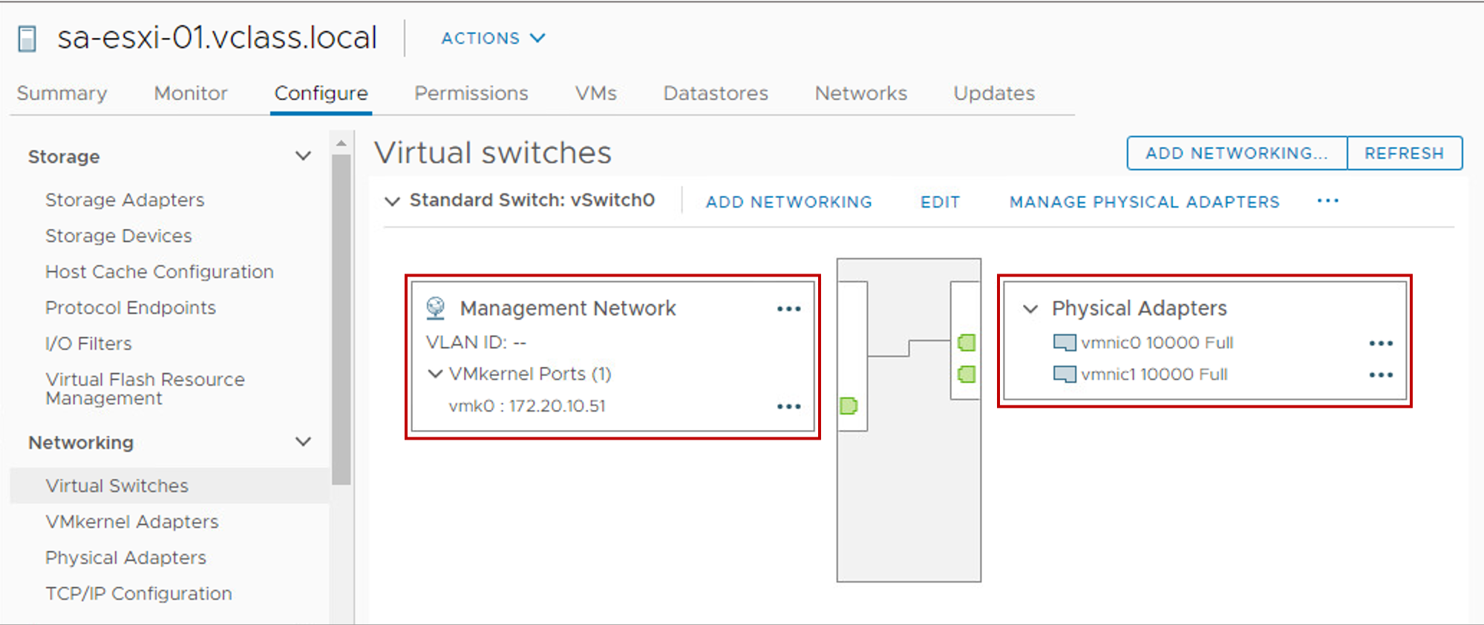
Redundancy Using NIC Teaming
A heartbeat network is implemented in the following ways:
By using a VMkernel port that is marked for management
By using a VMkernel port that is marked for vSAN traffic when vSAN is in use
You can use NIC teaming to create a redundant heartbeat network on ESXi hosts.
Notes:
In this example, vmnic0 and vmnic1 form a NIC team in the Management network. The vmk0 VMkernel port is marked for management.

Slide 54
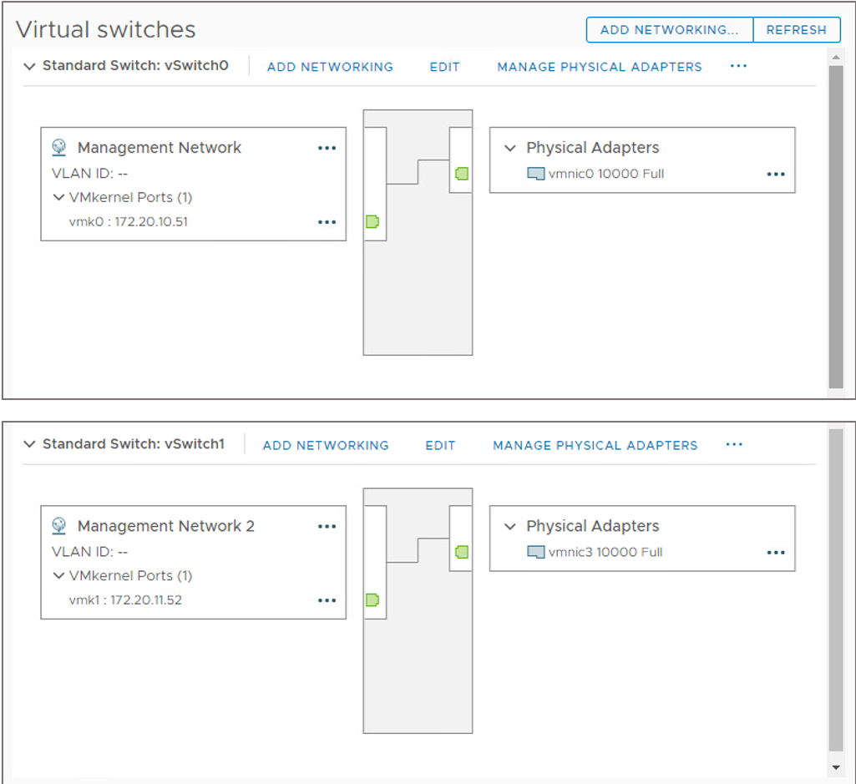
Redundancy Using Additional Networks
You can create redundancy by configuring more heartbeat networks.
On each ESXi host, create a second VMkernel port on a separate virtual switch with its own physical adapter.
Redundant management networking supports the reliable detection of failures and prevents isolation or partition conditions from occurring, because heartbeats can be sent over multiple networks.
Notes:
In most implementations, NIC teaming provides sufficient heartbeat redundancy, but as an alternative you can create a second management network connection attached to a separate virtual switch.
The original management network connection is used for network and management purposes. When the second management network connection is created, the master host sends heartbeats over both management network connections. If one path fails, the master host still sends and receives heartbeats over the other path.

Slide 55
Review of Learner Objectives
After completing this lesson, you should be able to meet the following objectives:
Identify options for configuring a highly available vSphere environment
Describe how vSphere HA responds when an ESXi host, a virtual machine, or an application fails

Slide 56
Lesson 4: vSphere HA Architecture

Slide 57
Learner Objectives
After completing this lesson, you should be able to meet the following objectives:
Identify the heartbeat mechanisms used by vSphere HA
Describe failure scenarios
Recognize vSphere HA design considerations

Slide 58
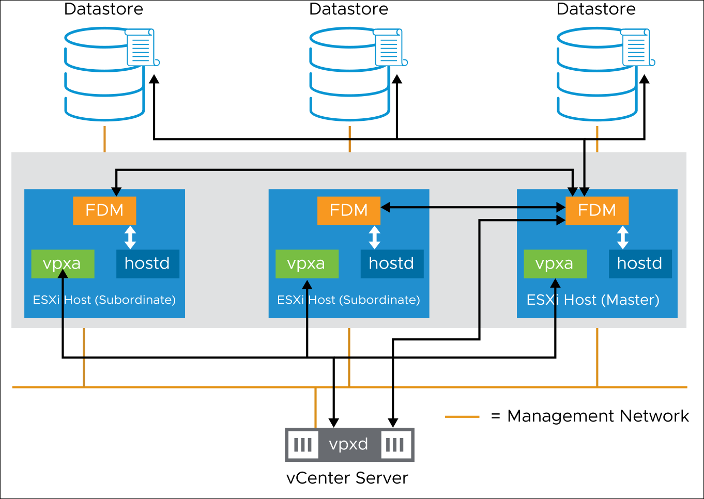
vSphere HA Architecture: Agent Communication
When vSphere HA is enabled in a cluster, the Fault Domain Manager (FDM) service starts on the hosts in the cluster.
Notes:
The vSphere HA cluster is managed by a master host. All other hosts are called subordinate hosts. Fault Domain Manager (FDM) services on subordinate hosts all communicate with FDM on the master host. Hosts cannot participate in a vSphere HA cluster if they are in maintenance mode, in standby mode, or disconnected from vCenter Server.
To determine which host is the master host, an election process takes place. The host that can access the greatest number of datastores is elected the master host. If more than one host sees the same number of datastores, the election process determines the master host by using the host Managed Object ID (MOID) assigned by vCenter Server.
The election process for a new master host completes in approximately 15 seconds and occurs under these circumstances:
vSphere HA is enabled.
The master host encounters a system failure because of one of the following factors:
The master host is placed in maintenance mode.
The master host is placed in standby mode.
vSphere HA is reconfigured.
The subordinate hosts cannot communicate with the master host because of a network problem.
During the election process, the candidate vSphere HA agents communicate with each other over the management network, or the vSAN network in a vSAN cluster, by using User Datagram Protocol (UDP). All network connections are point-to-point. After the master host is determined, the master host and subordinate hosts communicate using secure TCP. When vSphere HA is started, vCenter Server contacts the master host and sends a list of hosts with membership in the cluster with the cluster configuration. That information is saved to local storage on the master host and then pushed out to the subordinate hosts in the cluster. If additional hosts are added to the cluster during normal operation, the master host sends an update to all hosts in the cluster.
The master host provides an interface for vCenter Server to query the state of and report on the health of the fault domain and VM availability. vCenter Server tells the vSphere HA agent which VMs to protect with their VM-to-host compatibility list. The agent learns about state changes through hostd and vCenter Server learns through vpxa. The master host monitors the health of the subordinate hosts and takes responsibility for VMs that were running on a failed subordinate host.
A subordinate host monitors the health of VMs running locally and sends state changes to the master host. A subordinate host also monitors the health of the master host.
vSphere HA is configured, managed, and monitored through vCenter Server. The vpxd process, which runs on the vCenter Server system, maintains the cluster configuration data. The vpxd process reports cluster configuration changes to the master host. The master host advertises a new copy of the cluster configuration information and each subordinate host fetches an updated copy. Each subordinate host writes the updated configuration information to local storage. A list of protected VMs is stored on each datastore. The VM list is updated after each user-initiated power-on (protected) and power off (unprotected) operation. The VM list is updated after vCenter Server observes these operations.
A VM becomes protected when an operation results in a power on. Reverting a VM to a snapshot with memory state causes the VM to power on and become protected. Similarly, a user action that causes the VM to power off, for example, reverting to a snapshot without memory state or a standby operation performed in the guest, causes the VM to become unprotected.

Slide 59
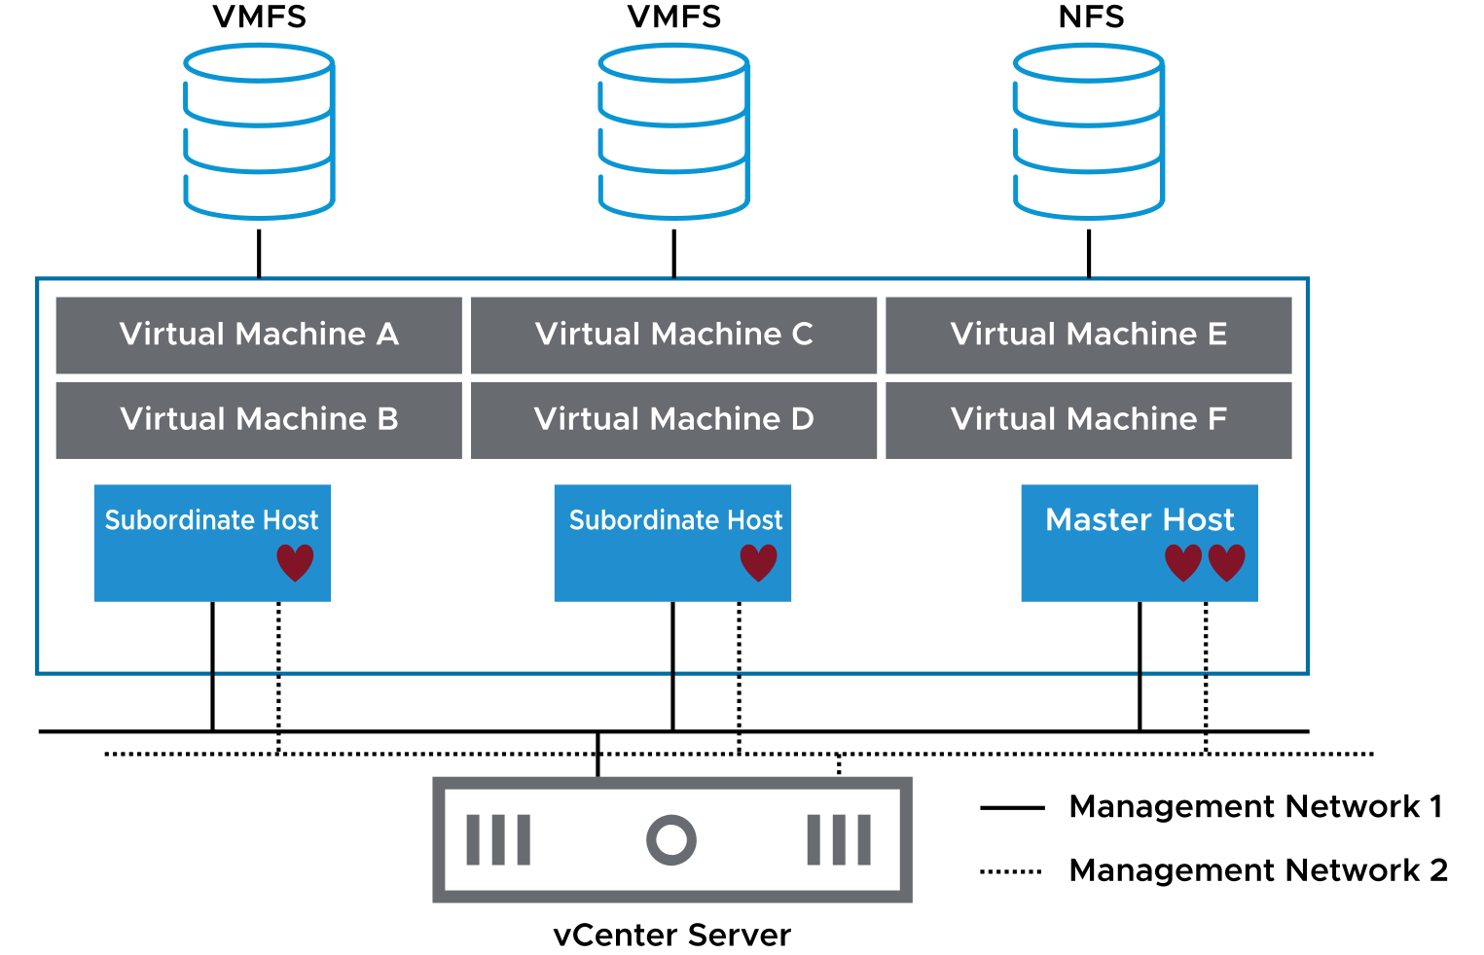
vSphere HA Architecture: Network Heartbeats
The master host sends periodic heartbeats to the subordinate hosts.
In this way, the subordinate hosts know that the master host is alive and the master host knows that the subordinate hosts are alive.
Notes:
Heartbeats are sent to each subordinate host from the master host over all configured management networks. However, subordinate hosts use only one management network to communicate with the master host. If the management network used to communicate with the master host fails, the subordinate host switches to another management interface to communicate with the master host.
If the subordinate host does not respond within the predefined timeout period, the master host declares the subordinate host as agent unreachable. When a subordinate host is not responding, the master host attempts to determine the cause of the subordinate host’s inability to respond. The master host must determine whether the subordinate host crashed, is not responding because of a network failure, or the vSphere HA agent is in an unreachable state.

Slide 60
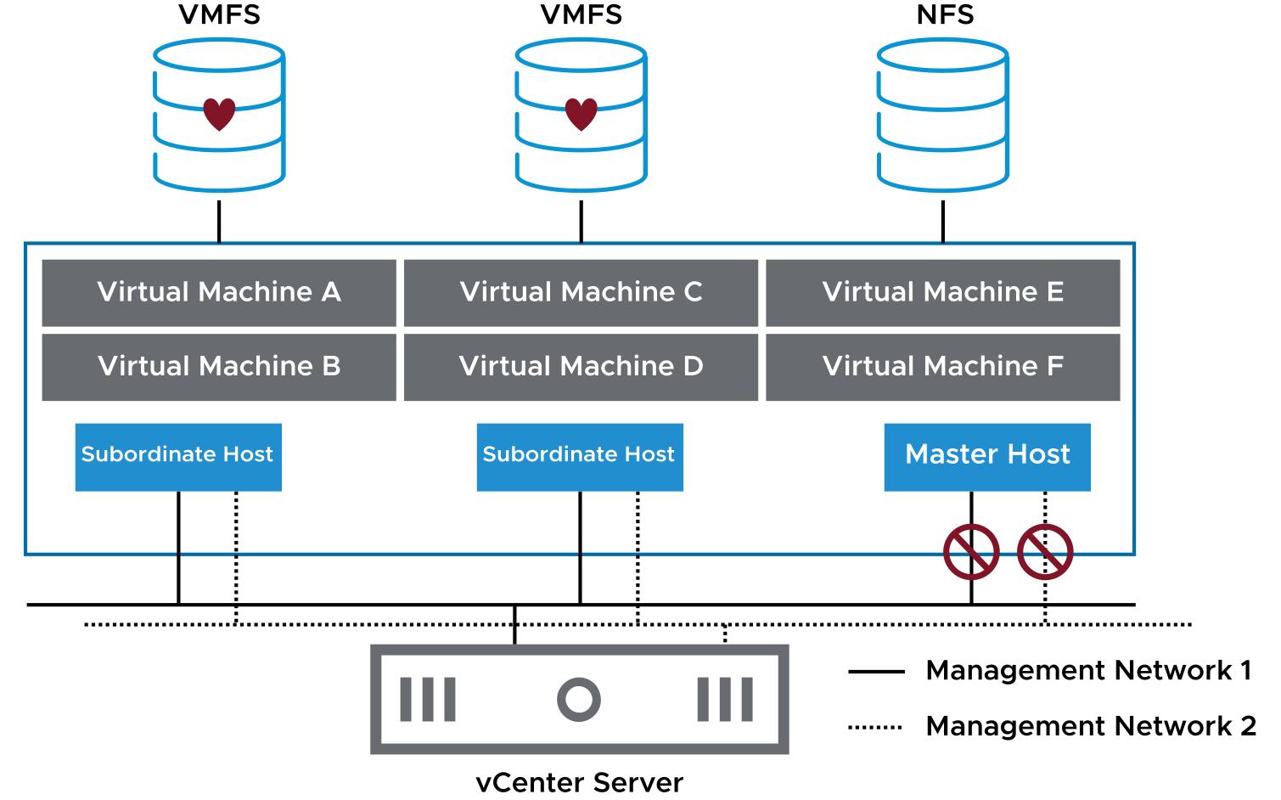
vSphere HA Architecture: Datastore Heartbeats
When the master host cannot communicate with a subordinate host over the management network, the master host uses datastore heartbeating to determine the cause:
Subordinate host failure
Network partition
Network isolation
Notes:
Using datastore heartbeating, the master host determines whether a host has failed or a network isolation has occurred. If datastore heartbeating from the host stops, the host is considered failed. In this case, the failed host’s VMs are started on another host in the vSphere HA cluster.

Slide 61
vSphere HA Failure Scenarios
vSphere HA can identify and respond to various types of failures:
Subordinate host failure
Master host failure
Network failure (host isolation)
VMCP enables vSphere HA to detect and respond to datastore access failures:
APD
PDL
Notes:
vSphere HA can also determine whether an ESXi host is isolated or has failed. Isolation refers to when an ESXi host cannot see traffic coming from the other hosts in the cluster and cannot ping its configured isolation address. If an ESXi host fails, vSphere HA attempts to restart the VMs that were running on the failed host on one of the remaining hosts in the cluster. If the ESXi host is isolated because it cannot ping its configured isolation address and sees no management network traffic, the host executes the Host Isolation Response.

Slide 62
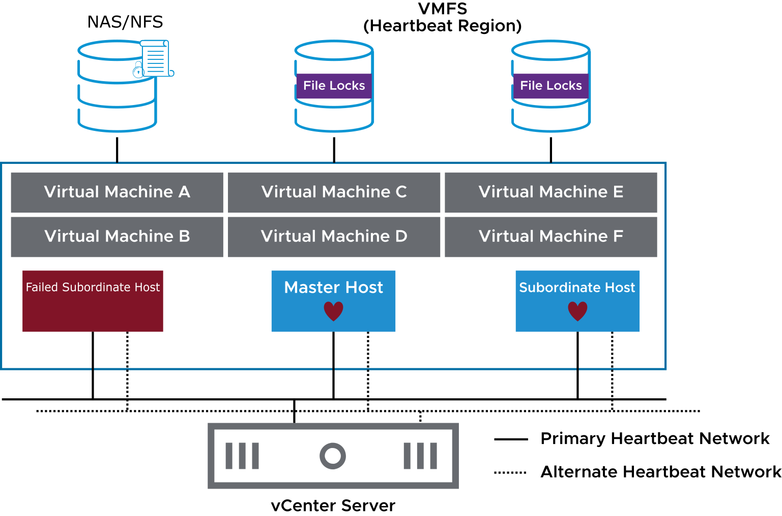
Failed Subordinate Hosts
When a subordinate host does not respond to the network heartbeat issued by the master host, the master host tries to identify the cause.
Notes:
The master host must determine whether the subordinate host is isolated or has failed, for example, because of a misconfigured firewall rule or component failure. The type of failure dictates how vSphere HA responds.
When the master host cannot communicate with a subordinate host over the heartbeat network, the master host uses datastore heartbeating to determine whether the subordinate host failed, is in a network partition, or is network-isolated. If the subordinate host stops datastore heartbeating, the subordinate host is considered to have failed, and its virtual machines are restarted elsewhere.
For VMFS, a heartbeat region on the datastore is read to find out if the host is still heartbeating to it. For NFS datastores, vSphere HA reads the host--hb file, which is locked by the ESXi host accessing the datastore. The file guarantees that the VMkernel is heartbeating to the datastore and periodically updates the lock file. The lock file time stamp is used by the master host to determine whether the subordinate host is isolated or has failed. In both storage examples, the vCenter Server instance selects a small subset of datastores for hosts to heartbeat to. The datastores that are accessed by the greatest number of hosts are selected as candidates. But two datastores are selected (by default) to keep the associated overhead and processing to a minimum.

Slide 63
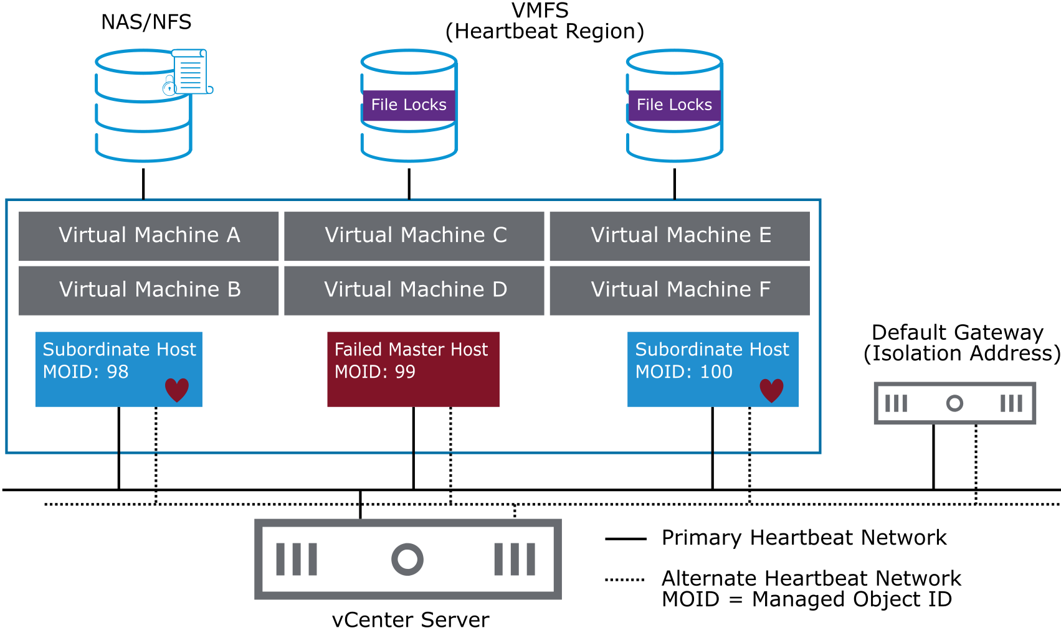
Failed Master Hosts
When the master host is placed in maintenance mode or fails, the subordinate hosts detect that the master host is no longer issuing heartbeats.
Notes:
To determine which host is the master host, an election process takes place. The host that can access the greatest number of datastores is elected the master host. If more than one host sees the same number of datastores, the election process determines the master host by using the host Managed Object ID (MOID) assigned by vCenter Server. If the master host fails, is shut down, or is removed from the cluster a new election is held.

Slide 64
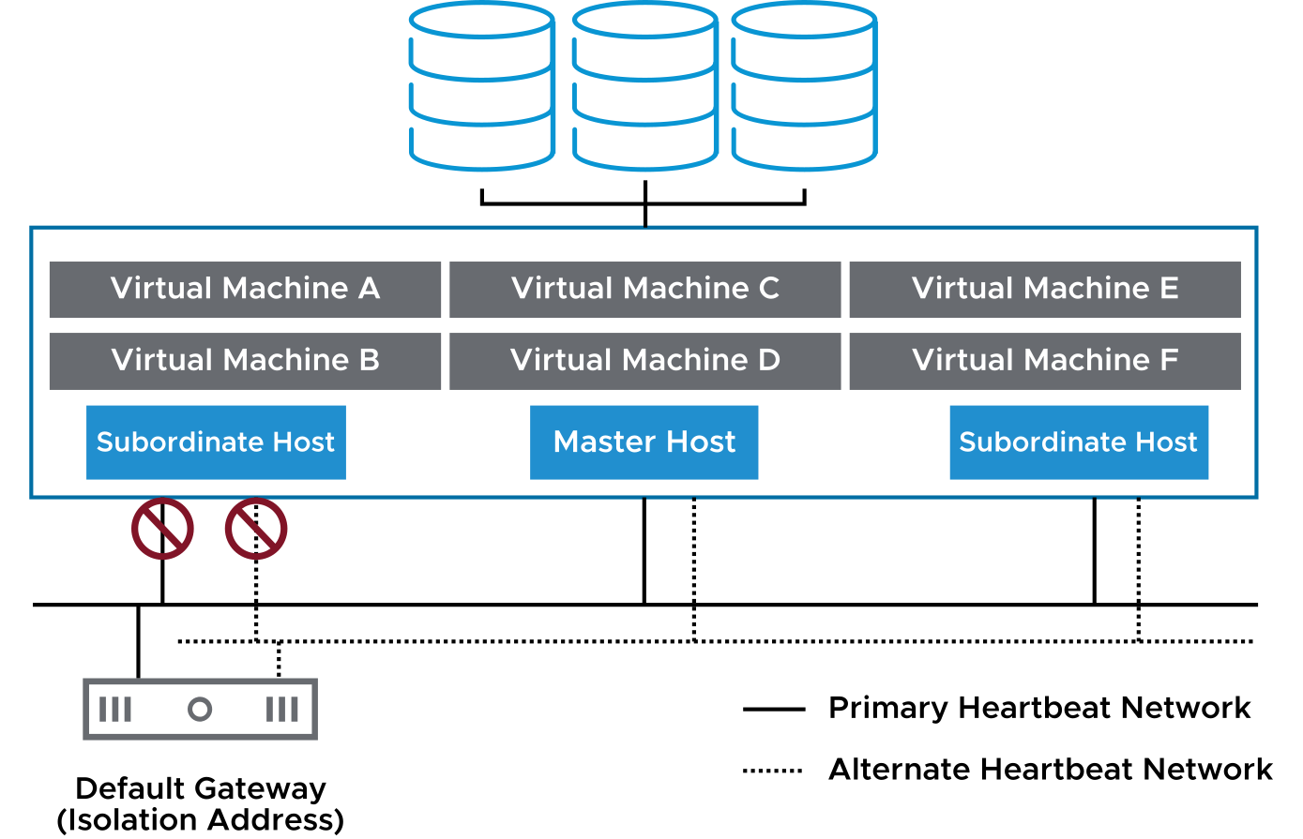
Isolated Hosts
A host is declared isolated when the following conditions occur:
The host is not receiving network heartbeats.
The host cannot ping its isolation addresses.
Notes:
The slide illustrates one of several scenarios that might result in host isolation. If a host loses connectivity to both the primary heartbeat network and the alternate heartbeat network, the host no longer receives network heartbeats from the other hosts in the vSphere HA cluster. Furthermore, the slide depicts that this same host can no longer ping its isolation address.
If a host becomes isolated, the master host must determine if that host is still alive, and merely isolated, by checking for datastore heartbeats. Datastore heartbeats are used by vSphere HA only when a host becomes isolated or partitioned.

Slide 65
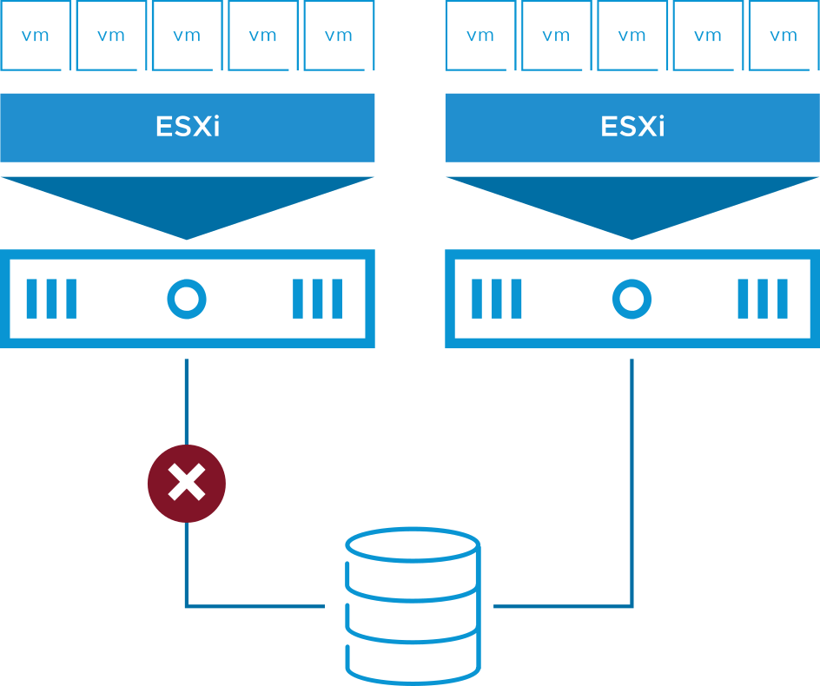
VM Storage Failures
Storage connectivity problems might arise because of:
Network or switch failure
Array misconfiguration
Power outage
Storage connectivity problems affect VM availability:
VMs on affected hosts are difficult to manage.
Applications with attached disks fail.

Slide 66
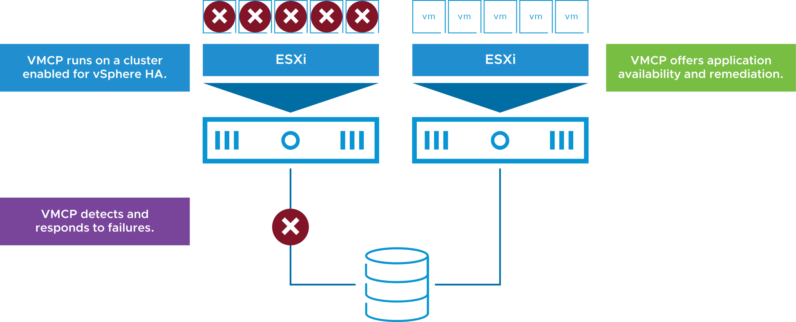
Protecting Against Storage Failures with VMCP
VM Component Protection protects against storage failures on a VM.
If VMCP is enabled, vSphere HA can detect datastore accessibility failures and provide automated recovery for affected VMs.
VMCP is not supported with vSAN.
Notes:
When a datastore accessibility failure occurs, the affected host can no longer access the storage path for a specific datastore. You can determine the response that vSphere HA gives to such a failure, ranging from the creation of event alarms to VM restarts on other hosts.

Slide 67
vSphere HA Design Considerations
When designing your vSphere HA cluster, consider these guidelines:
Implement redundant heartbeat networks and redundant isolation addresses:
Redundancy minimizes host isolation events.
Physically separate VM networks from the heartbeat networks.
Implement datastores so that they are separated from the management network by using one or both of the following approaches:
Use Fibre Channel over fiber optic for your datastores.
If you use IP storage, physically separate your IP storage network from the management network.
Notes:
If a datastore is based on Fibre Channel, a network failure does not disrupt datastore access. When using datastores based on IP storage (for example, NFS, iSCSI, or Fibre Channel over Ethernet), you must physically separate the IP storage network and the management network (the heartbeat network). If physical separation is not possible, you can logically separate the networks.

Slide 68
Review of Learner Objectives
After completing this lesson, you should be able to meet the following objectives:
Identify the heartbeat mechanisms used by vSphere HA
Describe failure scenarios
Recognize vSphere HA design considerations

Slide 69
Lesson 5: Configuring vSphere HA

Slide 70
Learner Objectives
After completing this lesson, you should be able to meet the following objectives:
Recognize the requirements for creating and using a vSphere HA cluster
Configure a vSphere HA cluster

Slide 71
vSphere HA Prerequisites
To create a vSphere HA cluster, you must meet several requirements:
All hosts must be configured with static IP addresses. If you are using DHCP, you must ensure that the address for each host persists across reboots.
All hosts must have at least one management network in common.
For VM monitoring to work, VMware Tools must be installed in every VM.
Only vSphere HA clusters that contain ESXi hosts 6.x and later can be used to enable VMCP.
You must not exceed the maximum number of hosts that are allowed in a cluster.
See VMware Configuration Maximums at https://configmax.vmware.com.
Notes:
To determine the maximum number of hosts per cluster, see VMware Configuration Maximums at https://configmax.vmware.com.

Slide 72
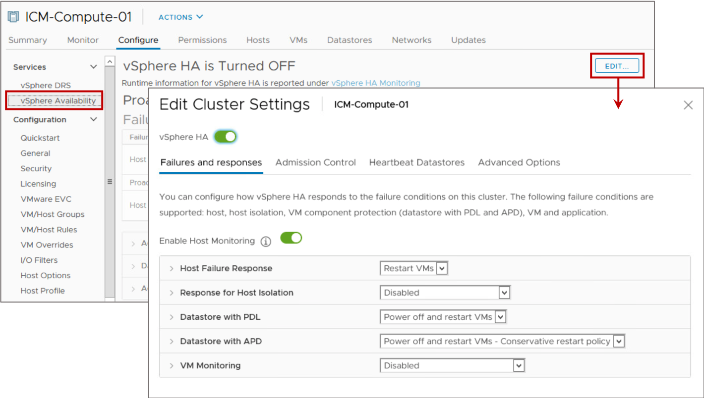
Configuring vSphere HA Settings
When you create or configure a vSphere HA cluster, you must configure settings that determine how the feature works.
Notes:
In the vSphere Client, you can configure the following vSphere HA settings:
Availability failure conditions and responses: Provide settings for host failure responses, host isolation, VM monitoring, and VMCP.
Admission control: Enable or disable admission control for the vSphere HA cluster and select a policy for how it is enforced.
Heartbeat datastores: Specify preferences for the datastores that vSphere HA uses for datastore heart-eating.
Advanced options: Customize vSphere HA behavior by setting advanced options.

Slide 73
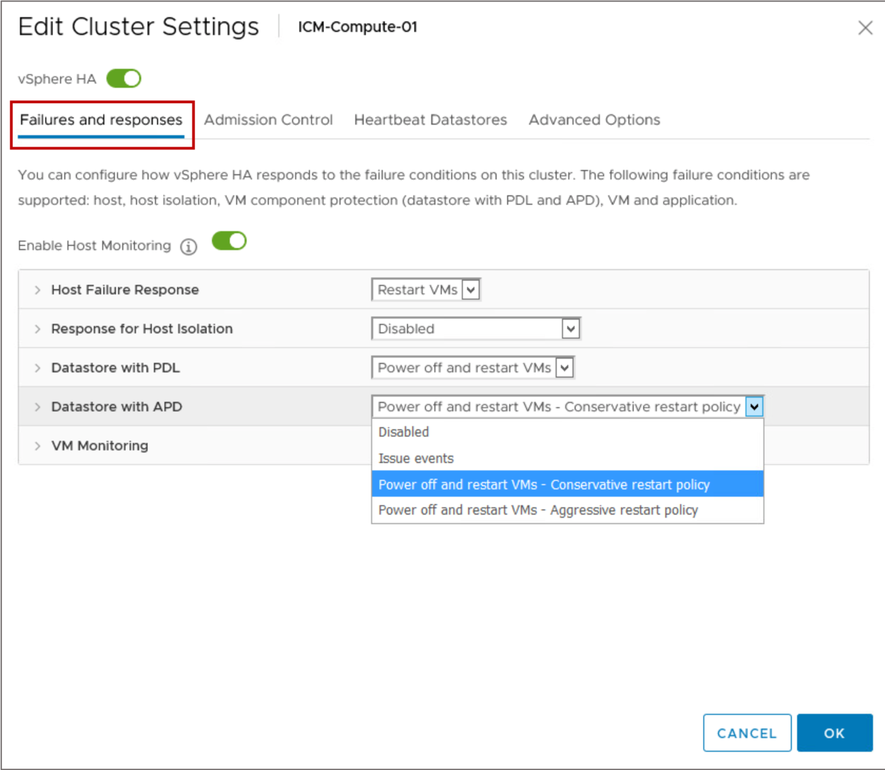
vSphere HA Settings: Failures and Responses
You use the Failures and responses pane to configure a cluster’s response if a failure occurs.
Notes:
Using the Failures and Responses pane, you can configure how your cluster should function when problems are encountered. You can specify the vSphere HA cluster’s response for host failures and isolation. You can also configure VMCP actions when permanent device loss and all paths down situations occur and enable VM monitoring.
If a datastore encounters an All Paths Down (APD) condition, the device state is unknown and might only be temporarily available. You can select the following options for a response to a datastore APD:
Disabled: No action is taken for the affected VMs.
Issue events: No action is taken against the affected VMs, however the administrator is notified when an APD event has occurred.
Power off and restart VMs - Conservative restart policy: vSphere HA does not attempt to restart the affected VMs unless vSphere HA determines that another host can restart the VMs. .
The host experiencing the APD communicates with the master host to determine whether sufficient capacity exists in the cluster to power on the affected VMs. If the master host determines sufficient capacity exists, the host experiencing the APD stops the VMs so that the VMs can be restarted on a healthy host. If the host experiencing the APD cannot communicate with the master host, no action is taken
Power off and restart VMs - Aggressive restart policy: vSphere HA stops the affected VMs even if it cannot determine that another host can restart the VMs.
The host experiencing the APD attempts to communicate with the master host to determine if sufficient capacity exists in the cluster to power on the affected VMs. If the master host is not reachable, sufficient capacity for restarting the VMs is unknown. In this scenario, the host takes the risk and stops the VMs so that they can be restarted on the remaining healthy hosts.
However, if sufficient capacity is not available, vSphere HA might not be able to recover all the affected VMs. This result is common in a network partition scenario where a host cannot communicate with the master host to get a definitive response to the likelihood of a successful recovery.
For more information about VM Component Protection, see https://blogs.vmware.com/vsphere/.

Slide 74
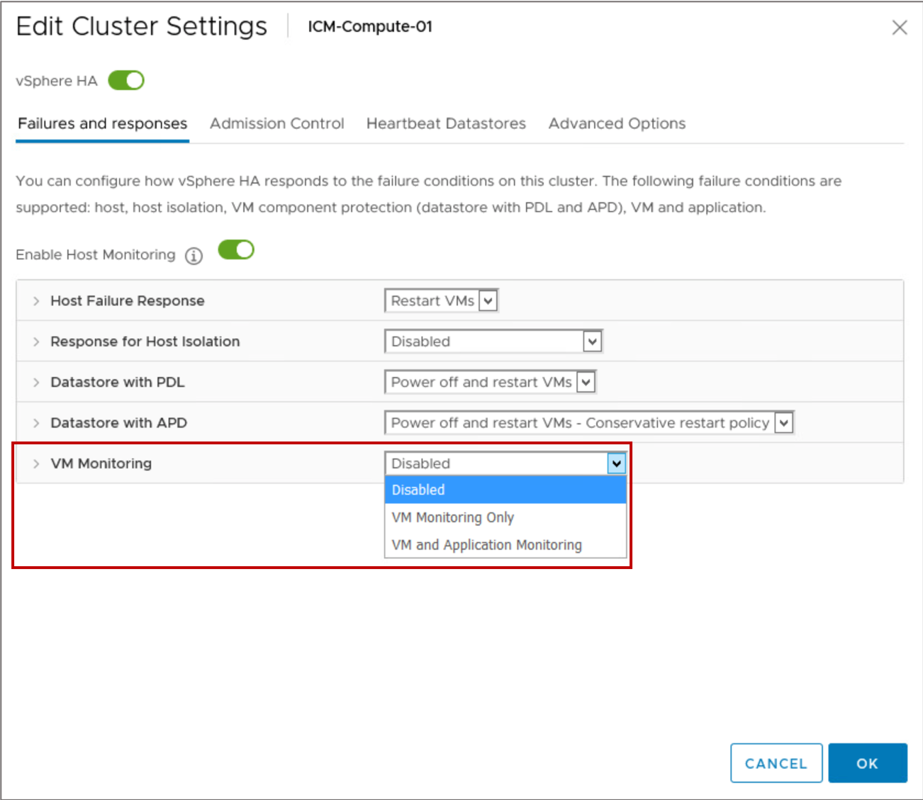
vSphere HA Settings: VM Monitoring
You use VM Monitoring settings to control the monitoring of VMs.
By default, VM Monitoring is set to Disabled.
Notes:
The VM monitoring service determines that the VM has failed if one of the following events occurs:
VMware Tools heartbeats are not received.
The guest operating system has not issued an I/O for the last 2 minutes (by default).
If the VM has failed, the VM monitoring service resets the VM to restore services.
You can configure the level of monitoring sensitivity. Highly sensitive monitoring results in a more rapid conclusion that a failure has occurred. Although unlikely, highly sensitive monitoring might lead to falsely identifying failures when the VM or application is still working but heartbeats have not been received because of factors like resource constraints. Low-sensitivity monitoring results in longer interruptions in service between actual failures and VMs being reset. Select an option that is an effective compromise for your needs.
You can select VM and Application Monitoring to enable application monitoring.

Slide 75
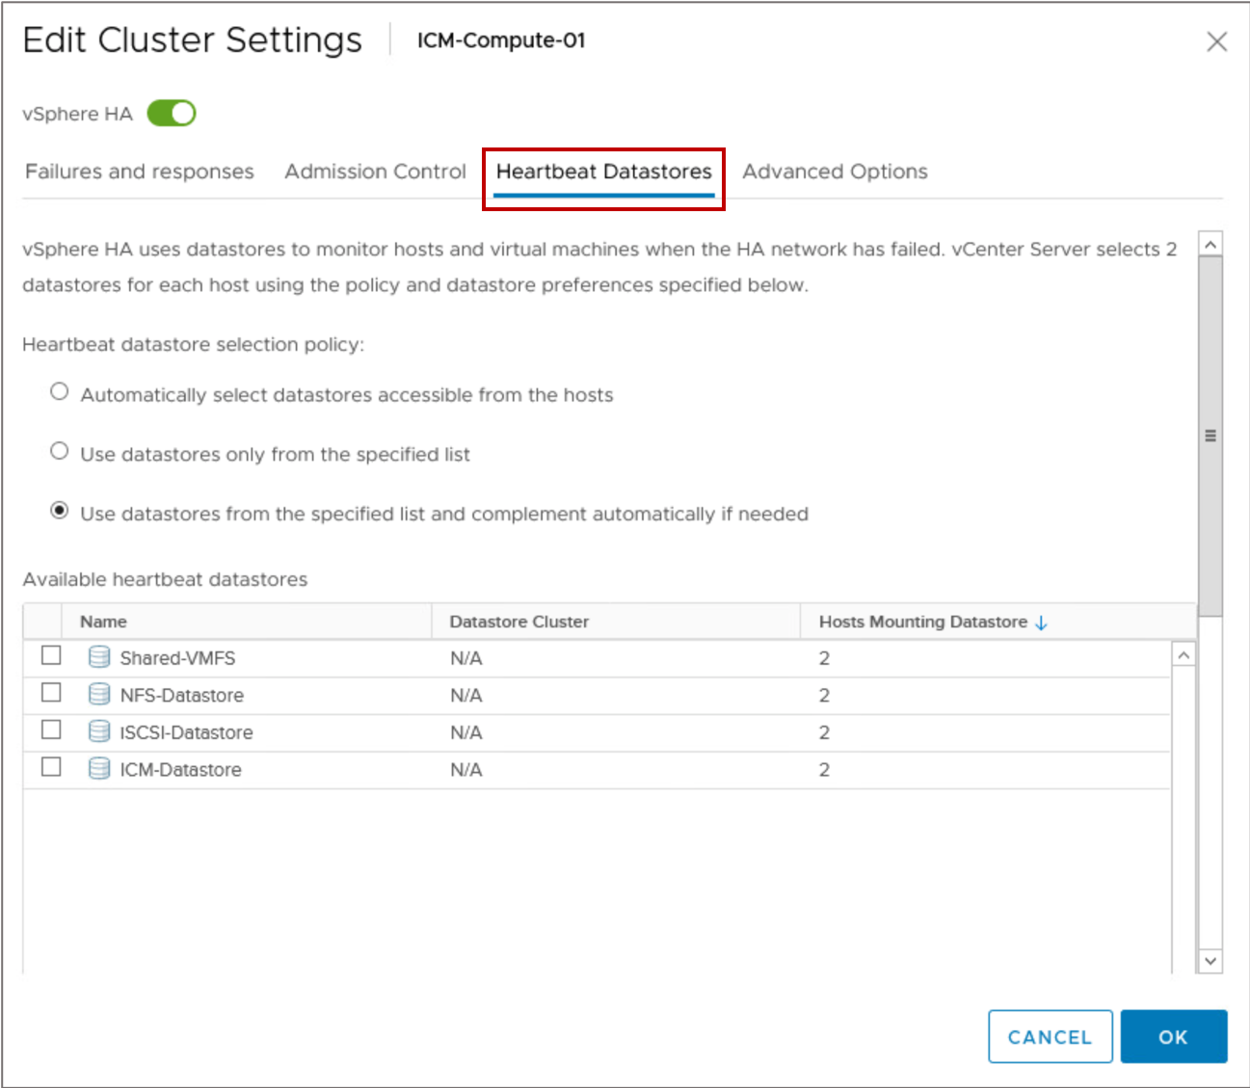
vSphere HA Settings: Heartbeat Datastores
A heartbeat file is created on the selected datastores and is used if the management network fails.
Notes:
Datastore heartbeating takes checking the health of a host to another level by checking more than the management network to determine a host’s health. You can configure a list of datastores to monitor for a particular host, or you can allow vSphere HA to decide. You can also combine both methods.

Slide 76
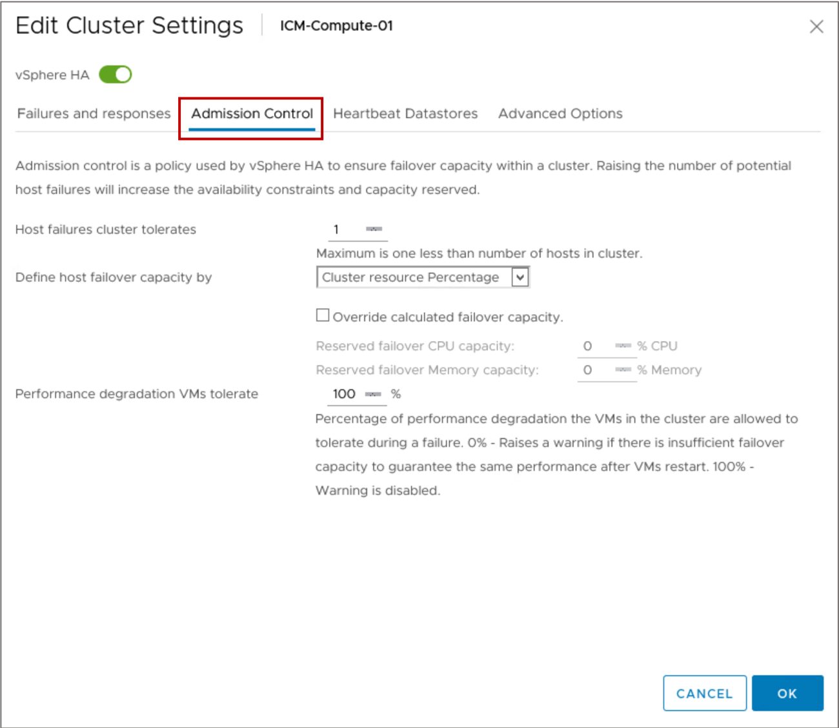
vSphere HA Settings: Admission Control
vCenter Server uses admission control to ensure both that sufficient resources are available in a cluster to provide failover protection and that VM resource reservations are respected.
Notes:
After you create a cluster, you can use admission control to specify whether VMs can be started if they violate availability constraints. The cluster reserves resources to allow failover for all running VMs for a specified number of host failures.
The admission control settings include:
Disabled: (Not recommended) This option disables admission control, allowing the VMs violating availability constraints to power on.
Slot Policy: A slot is a logical representation of memory and CPU resources. With the slot policy option, vSphere HA calculates the slot size, determines how many slots each host in the cluster can hold, and therefore determines the current failover capacity of the cluster.
Cluster resource Percentage: (Default) This value specifies a percentage of the cluster’s CPU and Memory resources to be reserved as spare capacity to support failovers.
Dedicated failover hosts: This option selects hosts to use for failover actions. If a default failover host does not have enough resources, failovers can still occur to other hosts in the cluster.

Slide 77
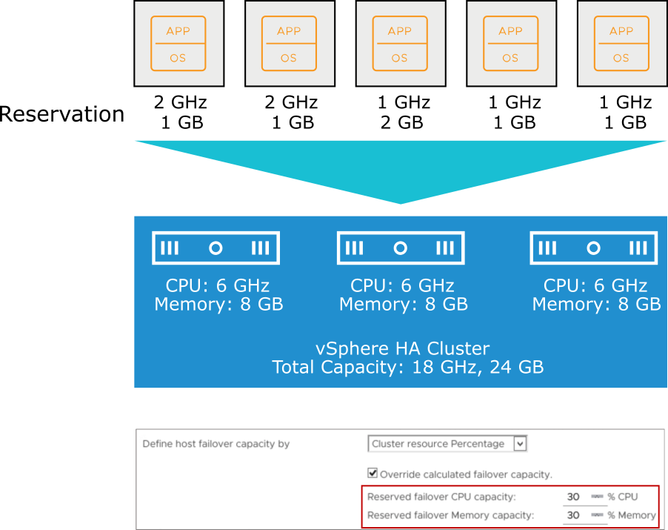
Example: Admission Control Using Cluster Resources Percentage
Example of calculating total failover capacity using cluster resource percentages:
Total cluster capacity:
CPU: 18 GHz
Memory: 24 GB
Total VM reservations:
CPU: 7 GHz
Memory: 6 GB
Current failover CPU capacity is 61%:
((18 GHz - 7 GHz)/18 GHz) = 61%
Current failover memory capacity is 75%:
((24 GB - 6 GB)/24 GB) = 75%
Notes:
Cluster resource percentage is the default admission control policy. Recalculations occur automatically as the cluster's resources change, for example, when a host is added to or removed from the cluster.

Slide 78
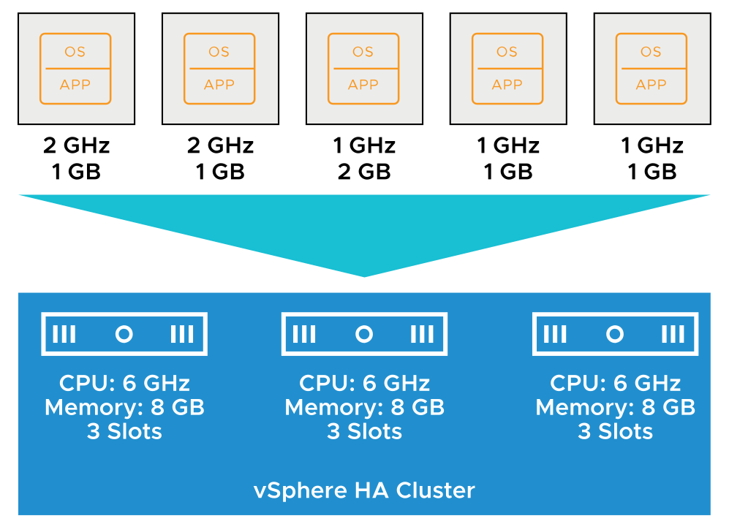
Example: Admission Control Using Slots (1)
A slot is calculated by combining the largest memory reservation and the largest CPU reservation of any running VM in the cluster.
vSphere HA performs admission control by calculating the following values:
Slot size:
In this example, the slot size is 2 GHz CPU and 2 GB memory.
Number of slots each host in the cluster can hold:
Three
The cluster has a total of nine slots (3 + 3 + 3).

Slide 79
Example: Admission Control Using Slots (2)
vSphere HA also calculates the current failover capacity. In this example, the failover capacity is one host:
If the first host fails, six slots remain in the cluster, which is sufficient for all five of the powered-on VMs.
If the first and second hosts fail, only three slots remain, which is insufficient for all five of the VMs.
If the current failover capacity is less than the configured failover capacity, vSphere HA does not allow any more VMs to power on.

Slide 80

vSphere HA Settings: Performance Degradation VMs Tolerate
The Performance degradation VMs tolerate threshold specifies the percentage of performance degradation that the VMs in the cluster are allowed to tolerate during a failure.
Notes:
Admission control can also be configured to offer warnings when the actual use exceeds the failover capacity percentage. The resource reduction calculation takes into account a VM's reserved memory and memory overhead.
By setting the Performance degradation VMs tolerate threshold, you can specify when a configuration issue should generate a warning or notice. For example:
The default value is 100 percent, which produces no warnings.
If you reduce the threshold to 0 percent, a warning is generated when cluster use exceeds the available capacity.
If you reduce the threshold to 20 percent, the performance reduction that can be tolerated is calculated as performance reduction = current use x 20 percent.
When the current use minus the performance reduction exceeds the available capacity, a configuration notice is issued.
The Performance degradation VMs tolerate threshold is not available unless vSphere DRS is enabled.

Slide 81

vSphere HA Setting: Default VM Restart Priority
The VM restart priority determines the order in which vSphere HA restarts VMs on a running host.
VMs are put in the Medium restart priority by default, unless the restart priority is explicitly set using VM overrides.
Exceptions:
Agent VMs always start first, and the restart priority is nonconfigurable.
vSphere Fault Tolerance secondary VMs fail over before regular VMs. Primary VMs follow the normal restart priority.
Notes:
Optionally, you can configure a delay when a certain restart condition is met.

Slide 82
vSphere HA Settings: Advanced Options
You can set advanced vSphere HA options to customize vSphere HA behavior.
Description | Option | Value
Force a cluster not to use the default isolation address (default gateway). | das.usedefaultisolationaddress | false
Force a cluster to ping alternate isolation addresses. | das.isolationaddressX | IP address or FQDN
Force a cluster to wait beyond the default 30-second isolation action window. | fdm.isolationpolicydelaysec | >=30 seconds
Force maximum bound on the memory slot size. | das.slotmeminmb | 100
Force maximum bound on the CPU slot size. | das.slotcpuinmhz | 32
Notes:
You can set advanced options that affect the behavior of your vSphere HA cluster. For more details, see vSphere Availability at https://docs.vmware.com/en/VMware-vSphere/7.0/com.vmware.vsphere.avail.doc/GUID-63F459B7-8884-4818-8872-C9753B2E0215.html.

Slide 83

vSphere HA Settings: VM-Level Settings
You can customize the restart priority for individual VMs in a cluster to override the default level set for the entire cluster.

Slide 84
About vSphere HA Orchestrated Restart
Orchestrated restart in vSphere HA enables five tiers for restarting VM and VM-VM dependencies.
Choose from among the following conditions that must be met before a VM is considered ready:
VM has resources secured.
VM is powered on.
VMware Tools heartbeat is detected.
VMware Tools application heartbeat is detected.
VMs can be grouped into tiers indicating their startup priority:
All VMs in the priority 1 tier receive their resources first and are powered on.
After all the VMs in tier 1 have met their defined restart condition, vSphere HA continues to the VMs in the priority 2 tier, and so on.
Notes:
After a host failure, VMs are assigned to other hosts with unreserved capacity, with the highest priority VMs placed first. The process continues to those VMs with lower priority until all have been placed or no more cluster capacity is available to meet the reservations or memory overhead of the VMs. A host then restarts the VMs assigned to it in priority order.
If insufficient resources exist, vSphere HA waits for more unreserved capacity to become available, for example, because of a host coming back online, and then retries the placement of these VMs. To reduce the chance of this situation occurring, configure vSphere HA admission control to reserve more resources for failures. With admission control, you can control the amount of cluster capacity that is reserved by VMs, which is unavailable to meet the reservations and memory overhead of other VMs if a failure occurs.

Slide 85

VM Dependencies in Orchestrated Restart (1)
VMs can depend only on other VMs of the same or higher priority. Only direct dependencies are supported. VM-to-VM dependency is a hard rule. Creating cyclical dependencies causes VM restart to fail.

Slide 86

VM Dependencies in Orchestrated Restart (2)
In vSphere 6.5 and later, vSphere HA restarts VMs only from a failed host. Configure affinity rules to keep VMs on the same host if necessary.
Notes:
To play the animation, go to https://vmware.bravais.com/s/JDg7NJ3DjVli7r6FiMQ0.

Slide 87

Network Configuration and Maintenance
Disable host monitoring before modifying virtual networking components that involve the VMkernel ports configured for management or vSAN traffic.
This practice prevents unwanted attempts to fail over VMs.
Notes:
The following network maintenance suggestions can help you avoid the false detection of host failure and network isolation because of dropped vSphere HA heartbeats:
Changing your network hardware or networking settings can interrupt the heartbeats used by vSphere HA to detect host failures, and might result in unwanted attempts to fail over VMs. When changing the management or vSAN networks of the hosts in the vSphere HA-enabled cluster, suspend host monitoring and place the host in maintenance mode.
Disabling host monitoring is required only when modifying virtual networking components and properties that involve the VMkernel ports configured for the Management or vSAN traffic, which are used by the vSphere HA networking heartbeat service.
After you change the networking configuration on ESXi hosts, for example, adding port groups, removing virtual switches, or suspending host monitoring, you must reconfigure vSphere HA on all hosts in the cluster. This reconfiguration causes the network information to be reinspected. Then, you must reenable host monitoring.

Slide 88

Monitoring vSphere HA Cluster Status
You can monitor the status of a vSphere HA cluster on the Summary page of the Monitor tab.
Notes:
You cluster or its hosts can experience configuration issues and other errors that adversely affect proper vSphere HA operation. You can monitor these errors on the Configuration Issues page.

Slide 89
Using vSphere HA with vSphere DRS
vSphere HA is closely integrated with vSphere DRS:
When a failover occurs, vSphere HA checks whether resources are available on that host for the failover.
If resources are not available, vSphere HA asks vSphere DRS to accommodate for the VMs where possible.
vSphere HA might not be able to fail over VMs for the following reasons:
vSphere HA admission control is disabled, and resources are insufficient in the remaining hosts to power on all the failed VMs.
Sufficient aggregated resources exist, but they are fragmented across hosts. In such cases, vSphere HA uses vSphere DRS to try to adjust the cluster by migrating VMs to defragment the resources.
Notes:
When vSphere HA performs failover and restarts VMs on different hosts, its first priority is the immediate availability of all VMs. After the VMs are restarted, the hosts in which they were powered on are usually heavily loaded, and other hosts are comparatively lightly loaded. vSphere DRS helps to balance the load across hosts in the cluster.

Slide 90
Lab 26: Using vSphere HA
Use vSphere HA functionality:
Enable vSphere HA in a Cluster
View Information About the vSphere HA Cluster
Configure Network Management Redundancy
Test the vSphere HA Functionality
View the vSphere HA Cluster Resource Usage
Configure the Percentage of Resource Degradation to Tolerate

Slide 91
Review of Learner Objectives
After completing this lesson, you should be able to meet the following objectives:
Recognize the requirements for creating and using a vSphere HA cluster
Configure a vSphere HA cluster

Slide 92
Lesson 6: Introduction to vSphere Fault Tolerance

Slide 93
Learner Objectives
After completing this lesson, you should be able to meet the following objectives:
Describe the features and benefits of using vSphere Fault Tolerance
Describe how vSphere Fault Tolerance works
Describe how vSphere Fault Tolerance works with vSphere HA and vSphere DRS
Enable vSphere Fault Tolerance using the vSphere Client

Slide 94

About vSphere Fault Tolerance
vSphere Fault Tolerance provides instantaneous failover and continuous availability:
Zero downtime
Zero data loss
No loss of VM network connectivity
Notes:
You can use vSphere Fault Tolerance for most mission-critical VMs. vSphere Fault Tolerance is built on the ESXi host platform.
The protected VM is called the primary VM. The duplicate VM is called the secondary VM. The secondary VM is created and runs on a different host to the primary VM. The secondary VM’s execution is identical to that of the primary VM. The secondary VM can take over at any point without interruption and provide fault-tolerant protection.
The primary VM and the secondary VM continuously monitor the status of each other to ensure that fault tolerance is maintained. A transparent failover occurs if the host running the primary VM fails, in which case the secondary VM is immediately activated to replace the primary VM. A new secondary VM is created and started, and fault tolerance redundancy is reestablished automatically. If the host running the secondary VM fails, the secondary VM is also immediately replaced. In either case, users experience no interruption in service and no loss of data.

Slide 95
vSphere Fault Tolerance Features
vSphere Fault Tolerance protects mission-critical, high-performance applications regardless of the operating system used.
vSphere Fault Tolerance:
Supports VMs configured with up to 8 vCPUs and 128 GB memory
Supports up to four fault-tolerant VMs per host with no more than eight vCPUs between them
Supports vSphere vMotion migration for primary and secondary VMs
Creates a secondary copy of all VM files and disks
Provides fast checkpoint copying to keep primary and secondary VMs synchronized
Supports multiple VM disk formats: thin provision, thick provision lazy-zeroed, and thick provision eager-zeroed
Can be used with vSphere DRS only when Enhanced vMotion Compatibility is enabled
Supports interoperability with vSAN
Notes:
You can use vSphere Fault Tolerance with vSphere DRS only when the Enhanced vMotion Compatibility feature is enabled.
When you enable EVC mode on a cluster, vSphere DRS makes the initial placement recommendations for fault-tolerant VMs, and you can assign a vSphere DRS automation level to primary VMs. The secondary VM always assumes the same setting as its associated primary VM.
When vSphere Fault Tolerance is used for VMs in a cluster that has EVC mode disabled, the fault-tolerant VMs are given the disabled vSphere DRS automation level. In such a cluster, each primary VM is powered on only on its registered host, and its secondary VM is automatically placed.

Slide 96

vSphere Fault Tolerance with vSphere HA and vSphere DRS
vSphere HA and vSphere DRS are vSphere Fault Tolerance aware:
vSphere HA:
Is required for vSphere Fault Tolerance
Restarts failed VMs
vSphere DRS:
Selects which hosts run the primary and secondary VM, when a VM is powered on
Does not automatically migrate fault-tolerant VMs
Notes:
A fault-tolerant VM and its secondary copy are not allowed to run on the same host. This restriction ensures that a host failure cannot result in the loss of both VMs.

Slide 97

Redundant VMDK Files
vSphere Fault Tolerance creates two complete VMs.
Each VM has its own .vmx configuration file and .vmdk files. Each VM can be on a different datastore.
Notes:
vSphere Fault Tolerance provides failover redundancy by creating two full VM copies. The VM files can be placed on the same datastore. However, VMware place these files on separate datastores to provide recovery from datastore failures.

Slide 98

vSphere Fault Tolerance Checkpoint
Changes on the primary VM are not processed on the secondary VM. The memory is updated on the secondary VM.
Notes:
To play the animation, go to https://vmware.bravais.com/s/a8GAXMVDFHxWLstdhM1G.

Slide 99

vSphere Fault Tolerance: Precopy
Using vSphere Fault Tolerance, a second VM is created on the secondary host. The memory of the source VM is then copied to the secondary host.
Notes:
To play the animation, go to https://vmware.bravais.com/s/XM1mrfVGU5vPd6HVfBfv.

Slide 100

vSphere Fault Tolerance Fast Checkpointing
The vSphere Fault Tolerance checkpoint interval is dynamic. It adapts to maximize the workload performance.
Notes:
To play the animation, go to https://vmware.bravais.com/s/KafKVBJNsBpY7hn5bmGs.
vSphere Fault Tolerance uses an algorithm that provides fast, continuous copying (checkpointing) of the primary host VM. The primary VM is copied (checkpointed) periodically, and the copies are sent to a secondary host. If the primary host fails, the VM continues on the secondary host at the point of its last network send.
The goal is to take checkpoints of VMs at least every 10 milliseconds. The primary VM is continuously copied (checkpointed), and these copies (checkpoints) are sent to a secondary host.
The initial complete copy (checkpoint) is created using a modified form of vSphere vMotion migration to the secondary host. The primary VM holds each outgoing network packet until the following copy (checkpoint) has been sent to the secondary host.
In vSphere Fault Tolerance, checkpoint data makes up the last changed pages of memory. The source VM is paused to access this memory. This pause is typically under one second.

Slide 101

vSphere Fault Tolerance Shared Files
vSphere Fault Tolerance has shared files. The shared.vmft file ensures that the primary VM always retains the same UUID. The .ft-generation file is for the split-brain condition.
Notes:
To play the animation, go to https://vmware.bravais.com/s/2c9Y6hQ4X4uFWWzSTeFk.
The shared.vmft file, which is found on a shared datastore, is the vSphere Fault Tolerance metadata file. This file contains the primary and secondary instance UUIDs and the primary and secondary vmx paths.
vSphere Fault Tolerance avoids split-brain situations, which can lead to two active copies of a virtual machine after recovery from a failure. The .ftgeneration file ensures that only one VM instance is designated as the primary VM.

Slide 102

Enabling vSphere Fault Tolerance on a VM
You can turn on vSphere Fault Tolerance for a VM using the vSphere Client.
Notes:
After you take all the required steps for enabling vSphere Fault Tolerance for your cluster, you can use the feature by turning it on for individual VMs.
Before vSphere Fault Tolerance can be turned on, validation checks are performed on a VM.
After these checks are passed, and you turn on vSphere Fault Tolerance for a VM, new options are added to the Fault Tolerance section of the VM's context menu. These options include turning off or disabling vSphere Fault Tolerance, migrating the secondary VM, testing failover, and testing restart of the secondary VM.
When vSphere Fault Tolerance is turned on, vCenter Server resets the VM’s memory limit to the default (unlimited memory) and sets the memory reservation to the memory size of the VM. While vSphere Fault Tolerance is turned on, you cannot change the memory reservation, size, limit, number of virtual CPUs, or shares. You also cannot add or remove disks for the VM. When vSphere Fault Tolerance is turned off, any parameters that were changed are not reverted to their original values.

Slide 103
Review of Learner Objectives
After completing this lesson, you should be able to meet the following objectives:
Describe the features and benefits of using vSphere Fault Tolerance
Describe how vSphere Fault Tolerance works
Describe how vSphere Fault Tolerance works with vSphere HA and vSphere DRS
Enable vSphere Fault Tolerance using the vSphere Client

Slide 104
Activity: Virtual Beans Clusters (1)
As a Virtual Beans administrator, you want to place ESXi hosts in a vSphere cluster for a scalable and highly available infrastructure. Match the goal to the feature that helps achieve the goal.
Goal
Add ESXi hosts to the data center and let vSphere balance the load across the hosts.
Make business-critical applications 99.99 percent available (downtime per year of 52.56 minutes).
Identify VMs that are experiencing serious resource contention.
Improve the performance of certain VMs by ensuring that they always run together on the same host.
vSphere Feature
vSphere HA
VM scores
Cluster Quickstart
vSphere Fault Tolerance
VM-Host affinity

Slide 105
Activity: Virtual Beans Clusters (2)
As a Virtual Beans administrator, you want to place ESXi hosts in a vSphere cluster for a scalable and highly available infrastructure. Match the goal to the feature that helps achieve the goal.
Virtual Beans Goals | vSphere Feature
Add ESXi hosts to the data center and let vSphere balance the load across the hosts. | vSphere DRS
Make business-critical applications 99.99 percent available (downtime per year of 52.56 minutes). | vSphere HA or vSphere Fault Tolerance
Identify VMs that are experiencing serious resource contention. | VM scores
Improve the performance of certain VMs by ensuring that they always run together on the same host. | VM-Host affinity

Slide 106
Key Points
When you create a cluster, you can enable vSphere DRS, vSphere HA, vSAN, and the ability to manage image updates on all hosts collectively.
vSphere DRS clusters provide automated resource management to ensure that a VM's resource requirements are satisfied.
vSphere DRS works best when the VMs meet vSphere vMotion migration requirements.
vSphere HA restarts VMs on the remaining hosts in the cluster.
You implement redundant heartbeat networks either with NIC teaming or by creating additional heartbeat networks.
vSphere Fault Tolerance provides zero downtime for applications that must always be available.
Questions?

